Slide 1

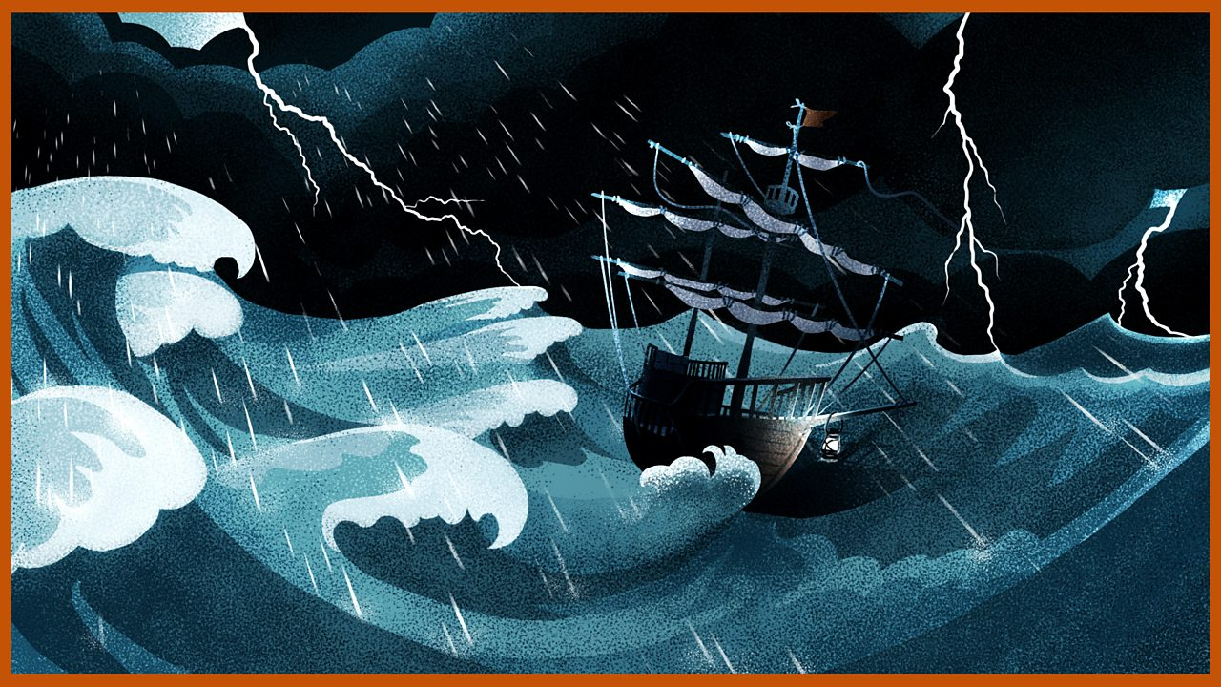

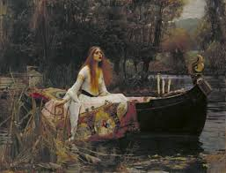


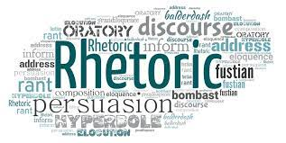

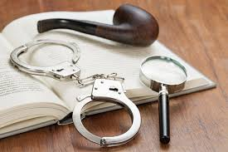

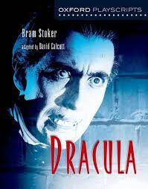
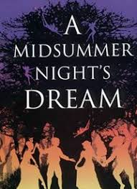
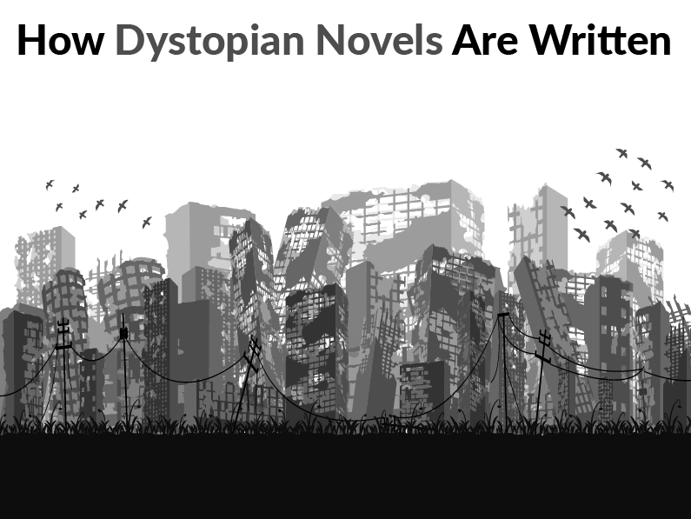

KEY STAGE 3
ENGLISH CURRICULUM
AUTUMN TERM 1
AUTUMN TERM 2
SPRING TERM 1
SPRING TERM 2
‘’Treasure Island”
Myths and Legends
Shakespeare ‘The Tempest’
The Play of‘ ‘Oliver Twist’
YEAR 7
Q2
AUTUMN TERM 1
SUMMER TERM 2
SUMMER TERM 1
The Art of Rhetoric
‘Max Kowalski Didn't Mean It’ by Susie Day
Detective Fiction‘
YEAR 8
SPOKEN LANGUAGE
AUTUMN TERM 2
Allegory and Rhetoric: ‘Animal Farm’ by George Orwell
Whilst studying these texts you will:
Think about how authors create meanings
Think about how texts relate to the world around you
Talk about the ideas and viewpoints in the texts you read
Write creatively
Write presenting your own perspective
YEAR 9
SPRING TERM 1
SPRING TERM 2
SUMMER TERM 1
SUMMER TERM 2
‘Shakespeare, ‘A Midsummer Night’s Dream’
Bram Stoker ‘Dracula’
Dystopian Fiction
Family Relationships: Poetry and 19th Century Fiction

Slide 2
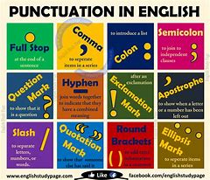

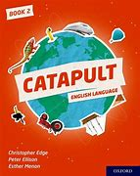

KEY STAGE 3
VOYAGE CURRICULUM
AUTUMN TERM 1 & 2
SPRING TERM 3 & 4
READING FLUENCY – CATAPULT BOOK 1
WRITING FLUENCY – PUNCTUATION & GRAMMAR
YEAR 7
Whilst studying you will:
Improve your reading fluency
Improve your vocabulary
Improve your punctuation and grammar
Improve your understanding of the texts you read.
SUMMER TERM 5 & 6
AUTUMN TERM 1 & 2
COMPREHENSION & VOCABULARY DEVELOPMENT
READING FLUENCY – CATAPULT BOOK 2
YEAR 8
SPRING TERM 3 & 4
YEAR 9
WRITING FLUENCY – PUNCTUATION & GRAMMAR
SUMMER TERM 5 & 6
COMPREHENSION & VOCABULARY DEVELOPMENT
LITERACY SKILLS
GETTING READY FOR GCSEs

Slide 3
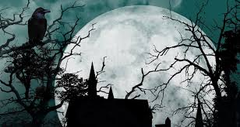
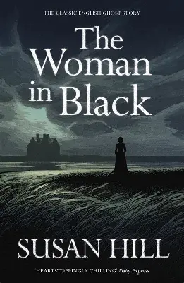
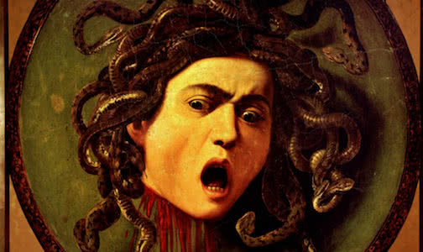

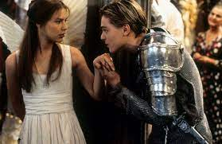

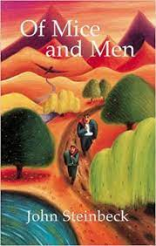
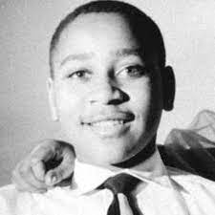

YEAR 9
English Curriculum
Genre Study: Gothic
Susan Hill ‘The Woman in Black’
Modern Poetry: Disturbed Voices
Terms 1 & 2
Terms 3 & 4
Viewpoints & Perspectives: Hidden Voices
Shakespeare: Romeo and Juliet
SPOKEN LANGUAGE
Terms 5 & 6
Whilst studying these texts you will:
Think about how authors create meanings
Think about how texts relate to the world around you
Talk about the ideas and viewpoints in the texts you read
Write creatively
Write presenting your own perspective
Jewell Parker Rhodes ‘Ghost Boys’
Prejudice and Discrimination
Year 10
John Steinbeck ‘Of Mice and Men’
Poetry of the Natural World

Slide 4




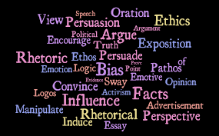




GCSE ENGLISH LANGUAGE & LITERATURE
KEY STAGE 4
ENGLISH CURRICULUM
‘’AN INSPECTOR CALLS’’
‘MACBETH’
YEAR 10
POWER & CONFLICT
LANG
‘A CHRISTMAS CAROL’
SPOKEN LANGUAGE
2024-2026
2 YEAR PLAN
YEAR 11
PAPER 1
PAPER 2
Viewpoints and Perspectives
Explorations in Creative Reading and Writing
Paper 2 Revision
Paper 1&2 Revision
PPE1
PPE 2
FINAL EXAMS
Lang Paper 2 and Lit Paper 1
Lang P1 and Lit Paper 2

Slide 5
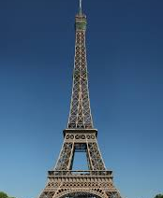

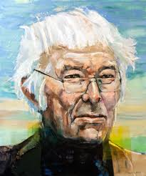
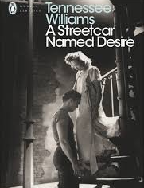

AQA A LEVEL ENGLISH LANGUAGE & LITERATURE
KEY STAGE 5: A LEVEL
ENGLISH LANGUAGE & LITERATURE
PARIS ANTHOLOGY
‘THE LOVELY BONES’
SEPT 2024
JUNE 2025
SEAMUS HEANEY
NEA
2024 - 2026
2 YEAR PLAN
SEPT 2025
‘A STREETCAR NAMED DESIRE’
‘THE GREAT GATSBY’
NEA
JUNE2026
REVISION

Slide 6

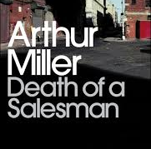
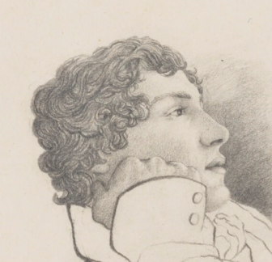
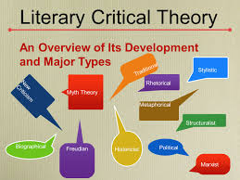
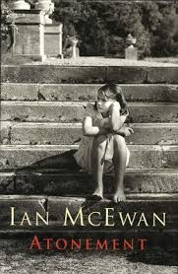
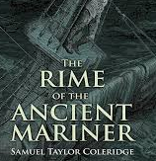


AQA A LEVEL ENGLISH LITERATURE
SPEC B
KEY STAGE 5: A LEVEL
ENGLISH LITERATURE
ASPECTS OF TRAGEDY ‘OTHELLO’
‘DEATH OF A SALESMAN’
JOHN KEATS
PAPER 1
CRITICAL ANTHOLOGY
NEA
ELEMENTS OF CRIME WRITING
PAPER 2
‘ATONEMENT’
‘HAMLET’
2024 - 2026
JUNE2026
2 YEAR PLAN
‘THE RIME OF THE ANCIENT MARINER’
UNSEEN PROSE

