Slide 1

WJEC
LEVEL 3 CRIMINOLOGY
INTRODUCTION PROJECT 2024
Name: _______________________

Slide 2
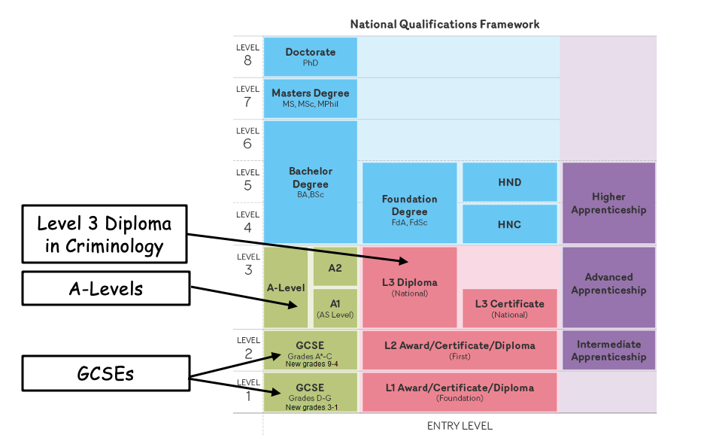
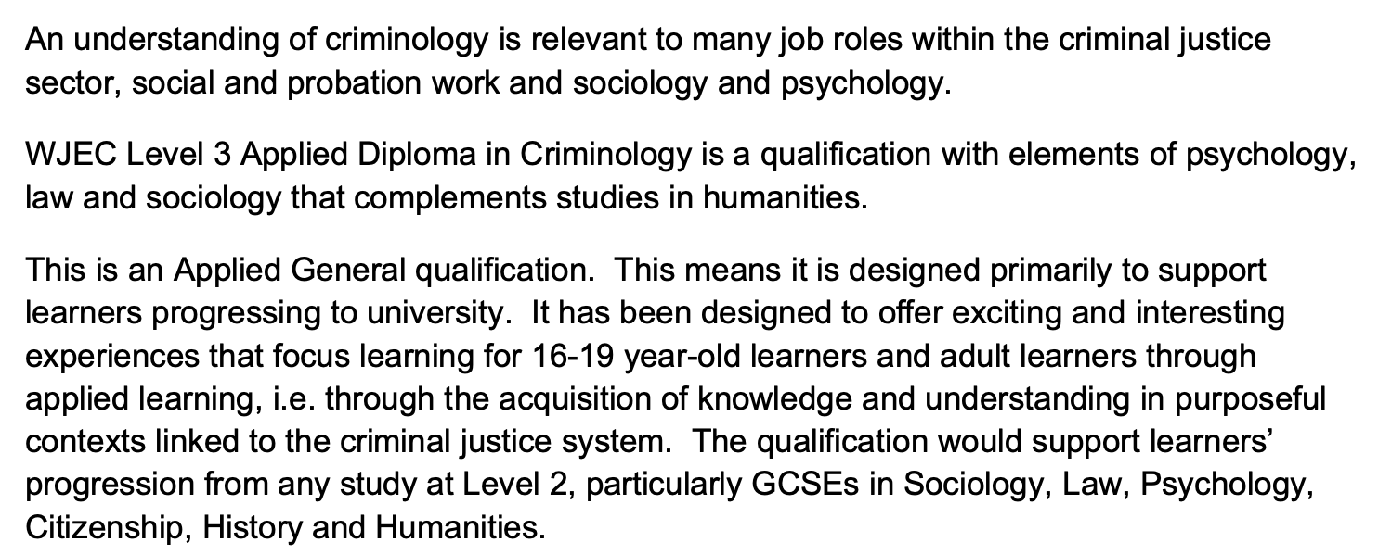
WHAT IS A LEVEL 3 DIPLOMA?
This qualification is not an A-level and it is not a BTEC – it’s a Level 3 Diploma in Criminology.
Although it’s not an A-level or a BTEC, it is the equivalent to studying one.
Take a look at the National Qualifications Framework to the left – it shows you how this qualification is equivalent to completing A-levels and even Advanced Apprenticeships.
WHY STUDY CRIMINOLOGY?
Criminology is 50% exam and 50% coursework meaning there is less pressure on your exam performance if this is something you worry about
50% of the qualification is complete in Year 12
We look at interesting topics such as causes of crime and miscarriages of justice
You will see examples of criminology in everyday life and will be able to apply your knowledge through meeting external visitors and visiting court
Achieving an A in this qualification is worth 48 UCAS points (as of June 2020) – helping you on your way to university
Criminology is the scientific study of crime, including its causes, responses by law enforcement, and methods of prevention.
Don’t just take our word for it – read what the specification says!
https://www.wjec.co.uk/qualifications/criminology-level-3/#tab_overview

Slide 3

HOW WILL I BE ASSESSED?
This qualification is made up of four units with each unit worth 25% of your final grade.
As mentioned previously, the first two units are completed in Year 12 with the last two being completed in Year 13.
50% EXAM
50% COURSEWORK
 | UNIT 1 (YEAR 12) | UNIT 2 (YEAR 12) | UNIT 3 (YEAR 13) | UNIT 4 (YEAR 13)
TITLE | CHANGING AWARENESS OF CRIME | CRIMINOLOGICAL THEORIES | CRIME SCENE TO COURTROOM | CRIME AND PUNISHMENT
ASSESSMENT | 8 HOUR CONTROLLED ASSESSMENT Feb 2025 | 90 MINUTE EXAM 75 MARKS MAY 2025 | 8 HOUR CONTROLLED ASSESSMENT Feb 2025 | 90 MINUTE EXAM 75 MARKS June 2025
WHAT DO WE LOOK AT? | What are the types of crime? How much crime are we really aware of? How can we raise awareness of crime? | What is the difference between crime and deviance? What are the reasons for committing crime? How can we use these reasons to tackle crime? | How do we process crime scenes? What does a trial look like? What is a miscarriage of justice? | How are laws made? Which agencies are responsible for controlling crime? Are prisons, the probation service and the police effective?
WHAT IS A CONTROLLED ASSESSMENT?
A controlled assessment is essentially a piece of coursework. During this qualification, you will complete two controlled assessments (Unit 1 and 3). They are each 8 hours long and are split over two days, normally 3 hours on the first day and 5 hours on the second. It involves you typing a report/document based on topics you have learnt in your lessons. Once this is complete, it is marked by your teacher and then checked by the exam board.

Slide 4
TRANSITION WORK
This is a detailed and comprehensive assignment that you have been given. Do not rush it. We advise that you complete the tasks gradually rather than leaving it all until the final week of your break.
You should expect to spend longer on these tasks than any homework you have completed before. L3 Criminology will be a significant step up from the work you have completed in Year 11.
Present the tasks in any format you like and bring it with you to your first lesson. If you are completing this work on a computer, please print or send it to either Mrs Last (rlast@kingswoodsecondaryacademy.org) or Mrs Jarvis (ljarvis@kingswoodsecondaryacademy.org)
If you have any questions or are struggling to complete a task please email – no question is too silly!
The work you complete as part of this booklet will be used in your first lessons of criminology… make a good impression!
 | TASK | ✓
1 | CRIMINOLOGY IN THE MEDIA Choose at least three documentaries to watch from the list and make a note of the key facts
2 | SERIAL KILLER FACT FILE Research a serial killer of your choice and produce a fact file
3 | ALL ABOUT HATE Answer the questions using the articles provided to find out more about hate crime
4 | WHAT DOES CRIME LOOK LIKE IN DIFFERENT AREAS? Use the crime maps to look at the different in amount and types of crime across different areas
5 | KEYWORDS Research the keywords and create a glossary
6 | CAMPAIGNS FOR CHANGE Research two of the campaigns and make notes according to the criteria

Slide 5



Watch at least three!
TASK 1: CRIMINOLOGY IN THE MEDIA
Did you know that approximately 20% of films are crime related and around 46% of media reports focus on violent/sexual crime? With this mind, it makes sense that some people feel that crime is all around them. This task will widen your knowledge of the different ways crime is portrayed in the media. Pick whichever of the following documentaries to watch as part of your introduction to criminology. Be sure to make a note of key events.
NETFLIX
Amanda Knox
Disappearance of Madeline McCann
When they see us
Confessions of a killer: The Ted Bundy Tapes
Making a Murderer
The Innocence Files
Evil Genius
The People vs OJ Simpson
Staircase
The Trials of Gabriel Fernandez
Killer Inside: The Mind of Aaron Hernandez
13th
Abducted in plain sight
American Murder (The Family Next Door)
YOUTUBE
Belmarsh: Inside Britain’s Toughest Prison
  (https://www.youtube.com/watch?v=mLRBpf-Ws6k)
Murder At Columbine High School
  (https://www.youtube.com/watch?v=D9mUpUHk3nE)
Hillsborough: anatomy of a disaster
  (https://www.youtube.com/watch?v=PYNeoTXe-SE)
Defending Violent Criminals
  (https://www.youtube.com/watch?v=Q15bAd8s08I)
Dr Death: Britain’s Biggest Serial Killer
  (https://www.youtube.com/watch?v=3-KVuVjmjmU)
Michelle Carter – Can Words Kill
  (https://www.youtube.com/watch?v=MfAG4O7ojxE)
Myra Hindley – Britain’s Most Hated Woman mmm(https://www.youtube.com/watch?v=NQ8eKB5fJRk)
The Boys Who Killed a Child (Jamie Bulger)
(https://www.youtube.com/watch?v=TrkQe4tyJnQ)
As you progress through this course, you will be able to look back at what you have watched and identify different aspects of criminology within it.

Slide 6
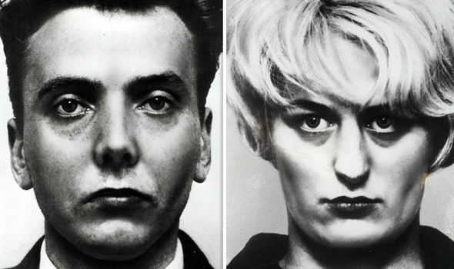
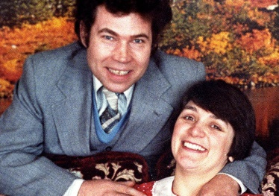
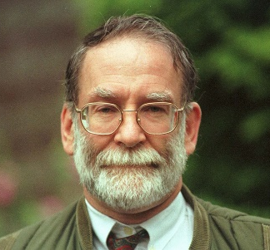
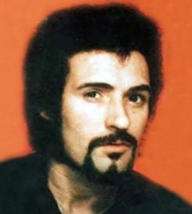
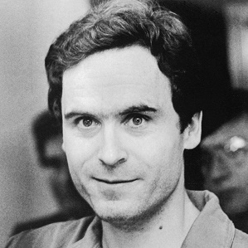
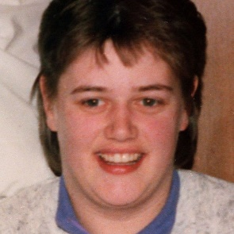
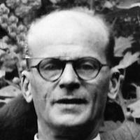
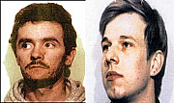
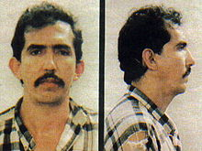
TASK 2: SERIAL KILLER FACT FILE
Although criminology isn’t all about gruesome serial killers, it will be useful for you to have some prior knowledge of this type of crime before you study the course. During Year 12, you will learn various causes of criminal behaviour and you will be able to link these to various serial killers. Choose a serial killer from the selection (or choose your own!) and research information according to the criteria below.
CRITERIA
What is their background?
  Where did they grow up? What was their family like? What was their life like before/during their crimes?
What crimes did they commit?
  How many people did they murder? How did they murder? What did they do with the bodies?
Who were their victims? Did they have a certain ‘type’?
Were they caught? If so, how were they punished?
Is there anything which might explain their behaviour? i.e. any head injuries, childhood abuse?
Ian Brady and Myra Hindley | Fred and Rose West | Harold Shipman
Peter Sutcliffe | Ted Bundy | Beverley Allitt
John Christie | John Duffy and David Mulcahy | Luis Garavito
If this task is a bit too upsetting/gruesome for you – please stop

Slide 7

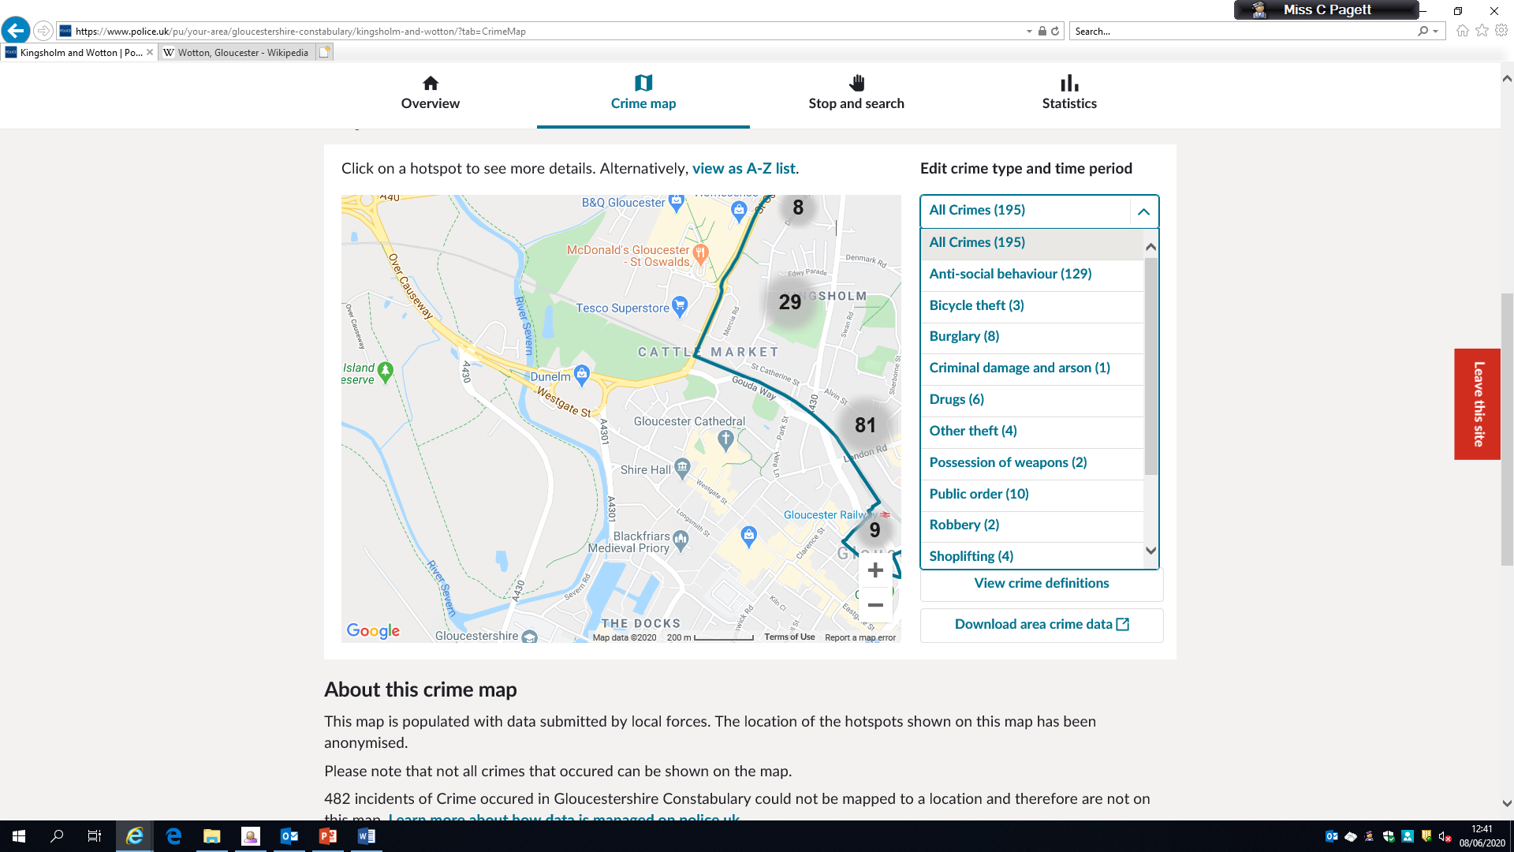
Task 2: All about hate crime•
TIP: Enter “UK” after your search to ensure you get relevant information – so instead of “hate crime” search “hate crime UK”
TASK 3: ALL ABOUT HATE
Since the public vote on BREXIT, there has been a marked increase in the amount of hate crime in the UK. There are various types of hate crime and it can be really upsetting to be a victim. This task will allow you to look at it in more detail and find out some real life examples. Use the articles and videos in the boxes below to help you complete the following tasks.
CRITERIA
What is hate crime? What are the different categories of hate crimes?
Find two examples of victims of hate crime and write a summary of each case
  Who was the perpetrator? Who was the victim?
  What crimes were committed?
  Did the perpetrator get punished? How?
Find two examples of support groups who help victims of hate crime and outline their aims and objectives
https://www.independent.co.uk/news/uk/crime/brexit-hate-crime-eu-citizens-xenophobia-racism-police-bracing-march-2019-article-50-a8590921.html
https://www.victimsupport.org.uk/crime-info/types-crime/hate-crime
http://www.stophateuk.org/
https://www.youtube.com/watch?v=B03jduD9N5o&safe=active
TASK 4: WHAT DOES CRIME LOOK LIKE IN DIFFERENT AREAS?
You will already know that different areas of the UK will have different crime rates but did you know that different areas have different types of crime? Think about the difference between urban, built up areas compared to rural areas – what would the difference in types of crime be? Use the two links below to look at the amount and types of crime that occur in Corby compared to Hertford, a small town in Hertfordshire.
https://www.police.uk/pu/your-area/northamptonshire-police/corby-town/?yourlocalpolicingteam=about-us&tab=crimemap
https://www.police.uk/pu/your-area/hertfordshire-constabulary/hertford/?yourlocalpolicingteam=about-us&tab=crimemap
Use the dropdown menu to see the different types of crime!
TIP: When looking at crime data, just stick to April 2021. This means when we discuss your findings in lesson, you should all have found the same pattern.

Slide 8
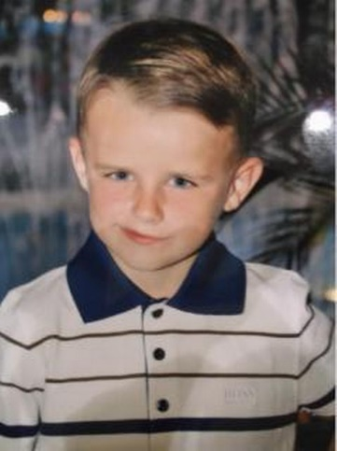
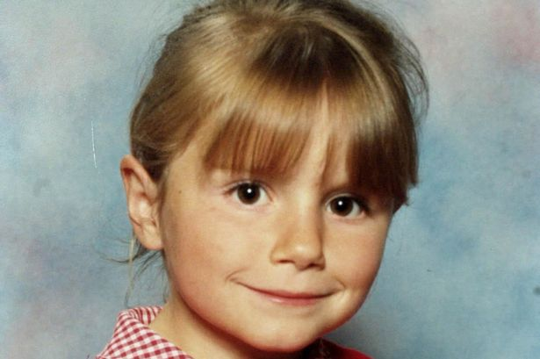
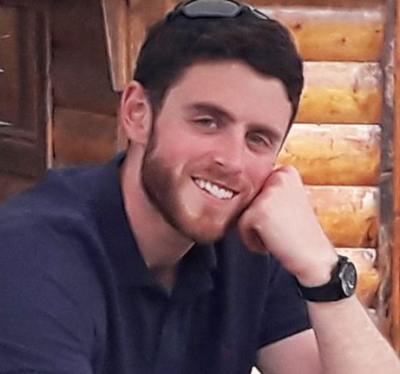
Task 2: All about hate crime•
TIP: Enter “Criminology” after your search to ensure you get relevant information and keywords defined from a criminology point of view.
TASK 5: KEYWORDS
Knowing your keywords is very important in Criminology. We often find that the answers getting top marks are the answers that contain keywords used appropriately and effectively.
Create a keyword glossary of the words below. If possible, try to use examples.
Crime | Deviance | White-collar crime
Technological crime | State crime | Moral crime
Domestic abuse | Hate crime | Honour crime
Ripple effect | Decriminalisation | Legalisation
TASK 6: CAMPAIGNS FOR CHANGE
A big focus of Unit 1 in Criminology is looking at how laws, policies and procedures have changed over time. You will also get the chance to plan your campaign. It therefore makes sense for us to start the course with a good set of knowledge about what existing campaigns are out there. Choose two of the following campaigns to research and makes notes using the criteria below.
CRITERIA
Why did this campaign start?
What was the aim of the campaign? What did they want to achieve?
How did they do it? What methods were involved? i.e. TV interviews, petitions
Was the campaign successful? Has it changed law/policy/procedure? Did it raise awareness?
CAMPAIGNS
Sarah’s Law
Double Jeopardy Law
Dignity in Dying
Snowdrop Campaign
Slow Down for Bobby
Harper’s Law

