Slide 1

How do I make effective revision notes?

Slide 2
Note Taking - The Evidence
The University of California conducted a 30 year study on the impact of note taking for revision.
Students who took notes during a lesson performed 12% better on a problem solving paper than those who took no notes.
But those students who made no notes did marginally better on questions that asked students to recall facts, statistics and quotes.
So to note take or not to note take – that is the question?

Slide 3
Note taking can have an impact if they are completed effectively:
Students who made their own notes at the end of each topic did 10-15% better on problem solving questions and 13-17% better on recalling facts than those who just took notes in the lesson.
Why??
Taking notes at the end of the topic means you are going over material that is already familiar to you (it’s in your working memory) and you are able to join the information together and make connections so that it is reinforced and eventually stored in your long term memory.

Slide 4
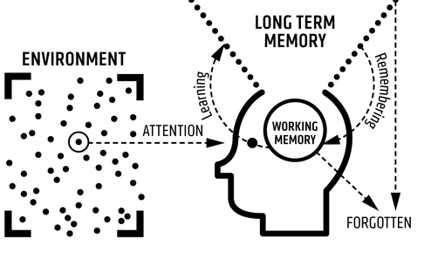
2. Stays in your working memory but will be forgotten if you don’t learn it. Learning means it gets stored in the long term memory.
As long as you keep returning to your learning it will stay in your long term memory.
1. Revision text book
4. Knowledge that is not revisited will be forgotten as if it was never learnt in the first place.

Slide 5
Typed or written?
Writing notes on your laptop means you are more likely to copy what has already been written.
Students who wrote notes on a laptop wrote 30% more words than those who used paper.
Laptop note taking leads to shallower learning as you are not thinking about what you are typing.
Using paper and pen means you are more likely to use your own words which helps your understanding. Also you go slower when writing so are more likely to select more important information which makes your revision more efficient.
Using your own words means you are making an emotional connection to the content. The more emotionally powerful a memory is the more likely it is to be stored in the long-term memory.

Slide 6
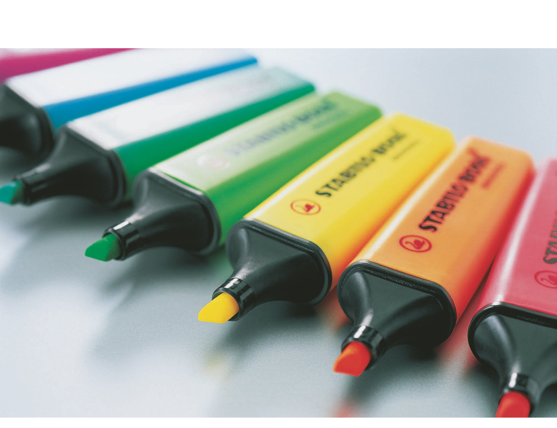
The curse of the highlighter
Highlighters can give a false sense of security.
Highlighting large chunks of text makes you feel you are doing something, but it is an ineffective revision tool when used in isolation.
Ideally highlighters should be used to identify key words that you can use for flash cards.
If you can’t break your highlighting habit, ensure that you highlight no more than one sentence per paragraph.

Slide 7
Effective use of Flash Cards
Highlight your notes to help create flash cards. A flash card should have a question on the front and the answer on the other side.
They can be used to memorise dates, vocab, formulas etc.
When you have created your flash cards use them to ensure the key knowledge is embedded in your long term memory by using the Leitner System.
Leitner System

