Slide 1

Planning for effective revision

Slide 2
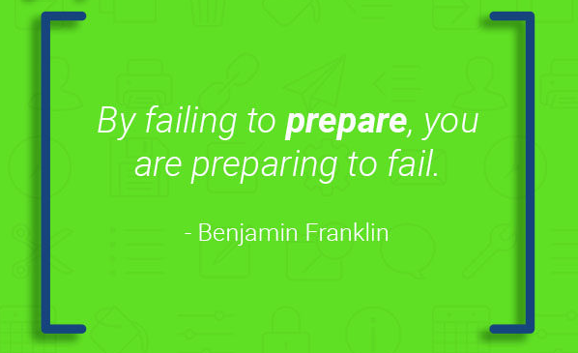



Slide 3

Why should I plan my revision?
Planning and breaking down into chunks the knowledge and skills that you need to know for each subject will make revision manageable and effective.
Having a plan means considering in detail what you are going to revise and how you are going to revise.
Even the most unlikeliest heroes have a plan!
Gru and Dru Planning to steal the big rock diamond

Slide 4
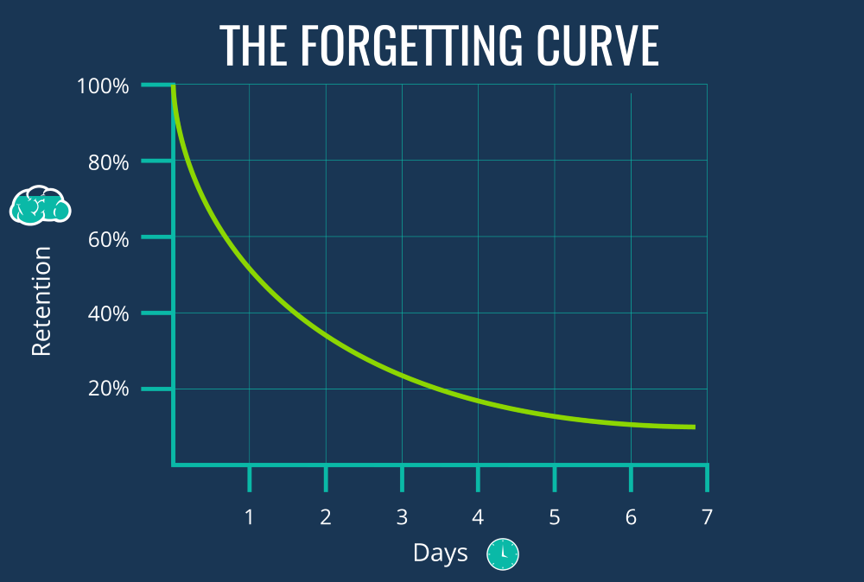
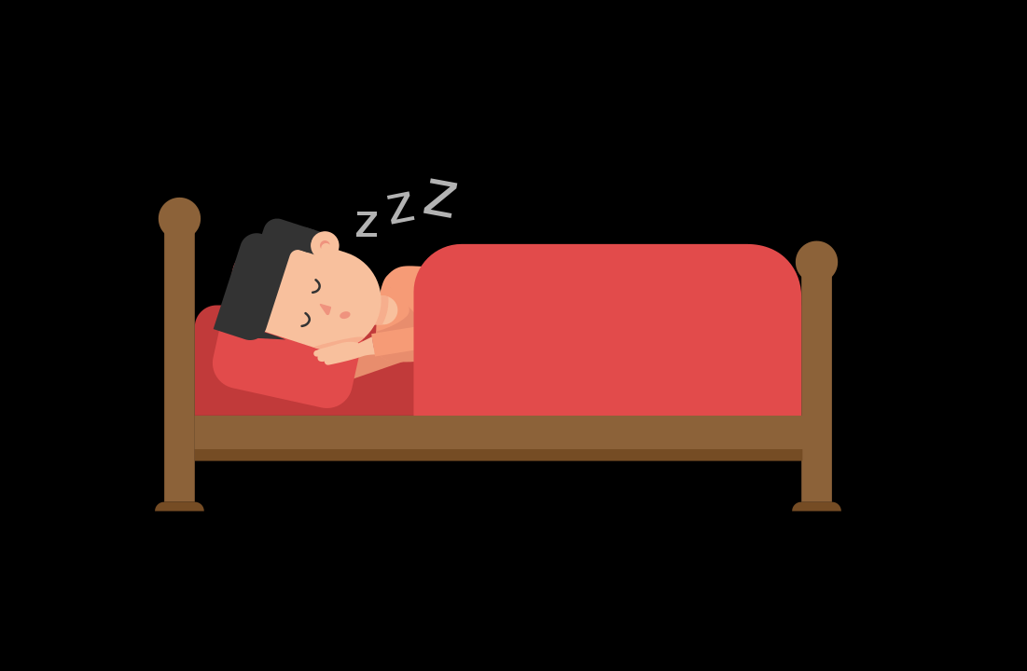
Planning for forgetting
It was believed that people suffer a drop in memory soon after the event but in reality people tend to remember the first and last things that happen.
We receive a boost to our memory 24 hours after and remember more in the morning of the second day than in the night of the first day. This jump is due to the power of sleep, so always make sure you get a good nights sleep.
Because we often forget information quickly, it is important to revisit it. The act of forgetting and re-learning cements the knowledge. into our long-term memory. Essentially doing one hour a day for seven days is more effective than doing seven hours in one day

Slide 5
Retrieval Practice
Scientific research from Washington University has found that student’s who adopt retrieval practice (answering questions about areas of study e.g. past exam papers) and distributed practice / spacing (doing bits of work over time rather than ‘cramming’) are more likely to be successful in exams and less stressed than those students who cram at the last moment.
Research shows that those students using retrieval processes outperformed by 17-26% those students who just read or highlighted their notes.
To commit something to memory takes time and repetition. This is important when completing revision timetables. It is not just what you revise that matters but the when as well.

Slide 6

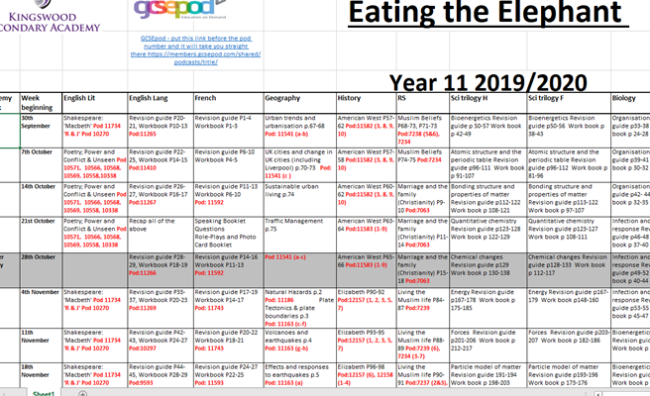

Revision Planners and Eat the Elephant Sheet
These will be handed out to you in form on Thursday.
The Eat the Elephant sheet will provide you with what you need to revise on a day-to-day basis.
Everything in green must be revised.
Use your planner to decide when you are revising and what you are revising. Make sure you plan in free time too.

