Slide 1

The most important resource for revision, is you.
Building resilience and Taking care of your own Wellbeing

Slide 2

What is resilience?
Resilience is the capacity to recover quickly from difficulties; to jump back after something has gone wrong.
The word originates from the Latin verb salire and means to jump.
Research has found three key attributes behind resilience:
A sense of perspective: Being able to self-reflect, manage emotions and focussing on the things that we can control.
Staying healthy: Physical activity and participating in social interactions that promote positive self-talk.
Social Support: Maintaining good relationships with friends, family and teachers helps you to feel better about setbacks

Slide 3

Why does it matter?
Many students feel that mistakes are bad and should be avoided at all costs. This can manifest itself in a student not trying / bothering to work as they want to avoid failure, or not achieving much as they are always starting their work / revision again.
Neither of these scenarios are good as ultimately the student is not learning.
Mistakes and setbacks are part of the learning process and are inevitable. They are also helpful as they help us to learn new strategies / knowledge / skills to overcome the mistake or setback and not to make the same mistake again.
The more resilient you are at accepting mistakes and setbacks the more likely you are to be successful, as you are more likely to perform under pressure.
Famous failures

Slide 4
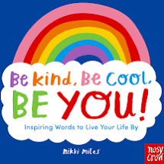
What can you do to build resilience?
Focus on what you stand to gain. Research of Olympic gold medallists found that they viewed their choices as active choices not sacrifices, and any setbacks were perceived as opportunities to grow and learn.
Ask yourself what can I do about this?
Do not catastrohise! Getting 3 maths problems wrong does not mean you are going to fail your GCSE.
Avoid using words like should and must.
Concentrate on positive and helpful thoughts.

Slide 5
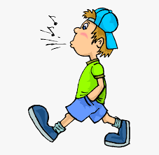
Taking care of your mental health
Research (Iowa State University) shows that those students who went for a short walk (12 minutes long) reported feeling much better than those students who had just sat around for 12 minutes.
Students who had a hard or boring task to do after the walk still reported having a positive mood boost as a result of going for a walk.
Scientific research shows that those who engage in regular exercise cope better with stressful situations.
The long term effects of regular exercise are well documented but even going for a short walk can provide a pick-me-up that boosts your mood for the rest of the day.
We all have mental health

Slide 6
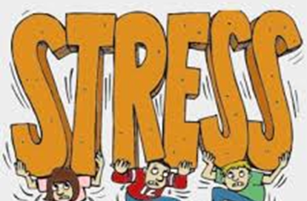
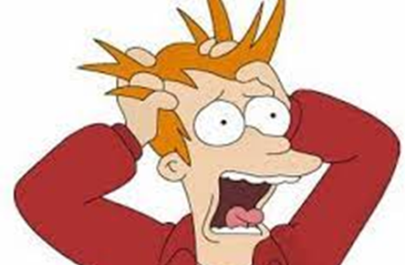
Stress
University College London found that uncertainty is a major cause of how stressed people feel, rather than worst case scenario thoughts.
Uncertainty triggers the stress hormone cortisol. Some stress and uncertainty is a good thing as it makes you take action, but too much can inhibit you and stop you thinking.
If people believe they have the skills and resources to meet the situation, then they feel in control and are more likely to view the event as a challenge which means stress levels remain manageable. This is why revision is good for you as it provides the skills and resources you need to pass assessments.

Slide 7
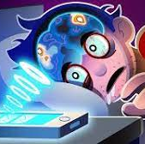
Sleep and Phones
The National Sleep Foundation recommends that teenagers need up to 10 hours sleep a night.
Getting a good nights sleep prior to learning allows you to create new memory associations more effectively. Not enough sleep hinders this ability.
When you are tired you are more likely to forget positive memories but more likely to remember negative ones – this is not good for your mental wellbeing.
You should always try to go to bed at the same time each night so that sleep becomes habitual and never be on your mobile phone prior to going to sleep. Scientific research shows that being on your phone, iPad or other electronical device 2 hours before you go to bed results in 20% less melatonin being released. Melatonin is the hormone that controls your sleep cycle.

