Slide 1
AQA combined science trilogy
Physics paper 1

Slide 2

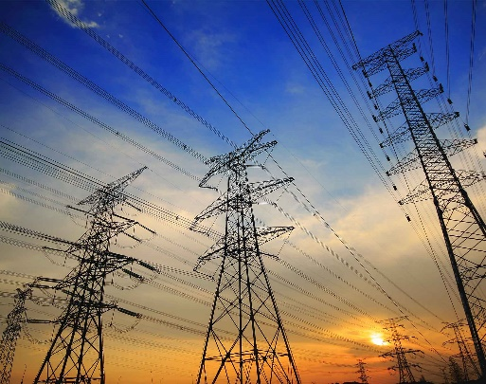
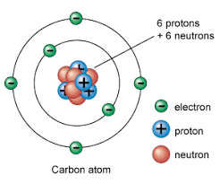
Physics paper 1
Energy
Electricity
Particle model of matter
Atomic structure

Slide 3


How do I review my learning on forms of energy and energy calculations?
Do Now Activity
Last Week: Name the four hormones that control the menstrual cycle? | Last Term: Which hormones are used in contraceptive pills?
Last Year: Outline the IVF process?
Notes:
Science

Slide 4
Energy
Energy stores and systems
Kinetic and potential energy stores
Specific heat capacity
Conservation of energy and power
Reducing unwanted energy transfers
Efficiency
Energy resources and their uses
Wind, solar, and geothermal
Hydroelectricity, waves and tidal
Biofuel and non renewable
Trends in energy resource use

Slide 5
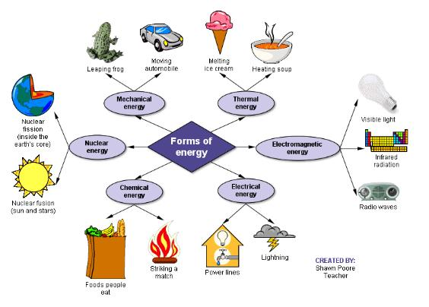
Energy
Changes in Energy Stores
Energy can be stored in a variety of different energy stores.
Energy is transferred by heating, by waves, by an electric current or by a force when it moves an object.
When an object falls and gains speed, its store of gravitational potential energy decreases and its kinetic energy store increases.
When a falling object hits the ground without bouncing back, its kinetic energy stores decreases. Some or all of its energy is transferred to the surroundings – the thermal energy store of the surroundings increases, and energy is also transferred by sound waves.

Slide 6
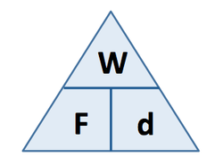
Energy
Conservation of Energy
Energy cannot be created or destroyed.
Conservation of energy applies to all energy changes.
A closed system is an isolated system in which no energy transfers take place out of or into the energy stores of the system.
Energy can be transferred between energy stores within a closed system.
The total energy of the closed system is always the same, before and after any transfers.
Energy and Work
Work is done on an object when a force makes the object move.
Energy transferred = work done
W = Fs where F is the force and s is the distance moved.
Work done to overcome friction is transferred as energy to the thermal energy stores of the objects that rub together and to the surroundings.

Slide 7
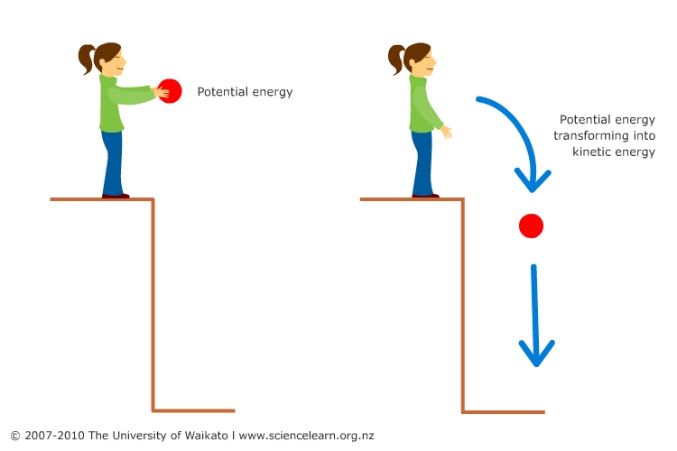
Energy
Gravitational Potential Energy Stores
The gravitational potential energy store of an object increases when it moves up and decreases when it moves down.
The gravitational potential energy store of an object increases when it is lifted up because work is done on it to overcome the gravitational force.
The gravitational field strength at the surface of the Moon is less than on the Earth.
Change of GPE (J) = mass (m) x gravitational field strength (N/kg) x change in height (m)
Kinetic Energy Stores
The energy in the kinetic energy store of a moving object depends on its mass and its speed.
Kinetic energy (J) = ½ x mass (kg) x speed² (m/s)²

Slide 8
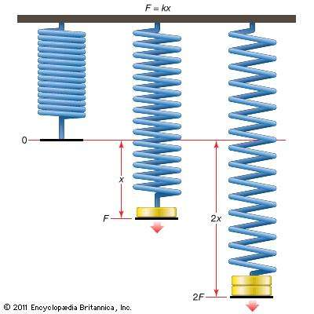
Energy
Elastic Energy Stores
Elastic potential energy is the energy stored in an elastic object when work is done on the object.
Elastic potential energy (J) = ½ x spring constant (N/m) x extension of the spring² (m)
Energy Dissipation
Useful energy is energy in the place we want it and in the form we need it.
Wasted energy is the energy that is not useful energy and is transferred by an undesired pathway.
Wasted energy is eventually transferred to the surroundings which become warmer.
As energy dissipates (spreads out) it gets less and less useful.

Slide 9
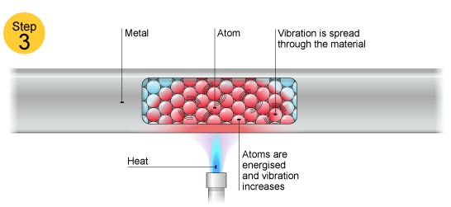
Energy
Energy Transfer by Conduction
Metals are the best conductors of energy.
Non-metal materials such as wool and fibreglass are the best insulators.
The higher the thermal conductivity of a material, the higher the rate of energy transfer through it.
The thicker a layer of insulating material, the lower the rate of energy transfer through it.
Specific Heat Capacity
The specific heat capacity of a substance is the amount of energy needed to change the temperature of 1kg of the substance by 1^{O}C.
The greater the mass of an object, the more slowly its temperature increases when heated.
Energy transferred (J) = Mass (kg) x specific heat capacity (J/kg ^{O}C) x temperature change (^{O}C)
RP

Slide 10
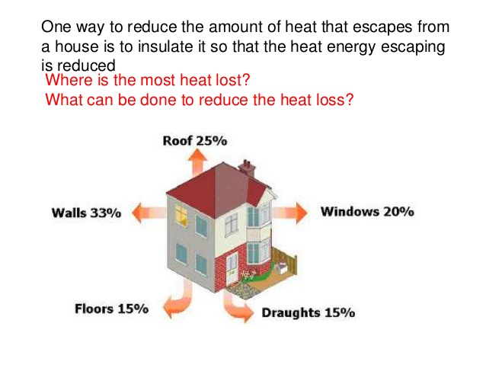
Energy
Heating and Insulating Buildings
Electric and/or gas heaters and gas or oil-filled central heating or solid-fuel stoves are used to heat houses.
The rate of energy transfer from houses can be reduced by using:
Loft insulation
Cavity wall insulation
Double-glazed windows
Aluminium foil behind radiators
External walls with thicker bricks and lower thermal conductivity.
Cavity wall insulation is insulation material that is used to fill the cavity between the 2 brick layers of an external house wall.

Slide 11
Energy
Energy and Efficiency
The efficiency of a device = useful energy transferred by the device (x 100%).
total energy supplied to the device
No energy transfer can be more than 100% efficient.
Machines waste energy because of friction between their moving parts, air resistance, electrical resistance and noise.
Machines can be made more efficient by reducing the energy they waste. For example, lubrication is used to reduce friction between moving parts.

Slide 12
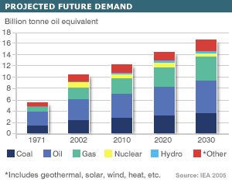
Energy
Energy Demands
Our energy demands are met mostly by burning oil, coal and gas.
Nuclear power, biofuels and renewable resources provide energy to generate some of the energy we use.
Uranium or plutonium is used in nuclear power stations.
Much more energy is released per kilogram from uranium or plutonium than from fossil fuels.
Biofuels are renewable sources of energy.
Biofuels such as methane and ethanol can be used to generate electricity.

Slide 13
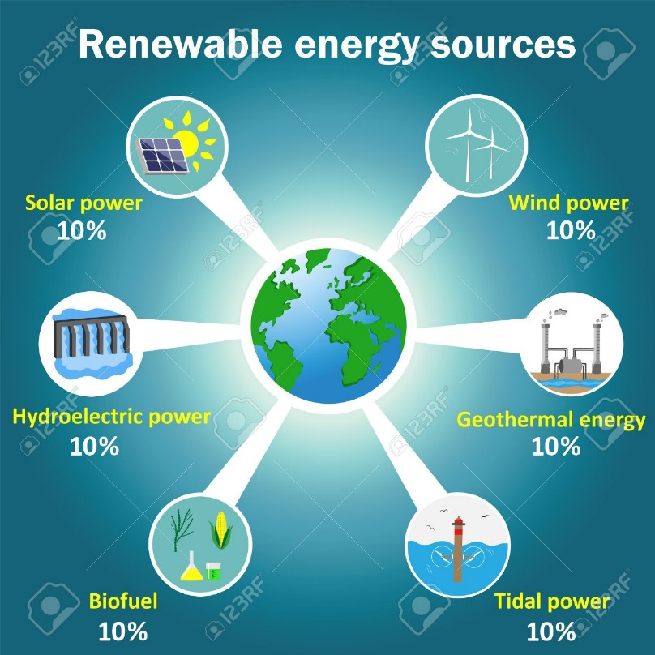
Energy
Renewable Electricity Generation
Wind turbine – generator on top of a tall tower
Waves – generate by turning a floating generator
Hydroelectricity – generators are turned by water running downhill
Tidal – trap each high tide and use the water to turn generators
Solar cells – convert solar energy directly into electricity
Solar heating panels – use solar energy to heat water directly
Geothermal – Water is pumped into hot rocks underground which produces steam to drive turbines. Rocks become hot due to the energy released by radioactive substances deep inside the Earth.

Slide 14
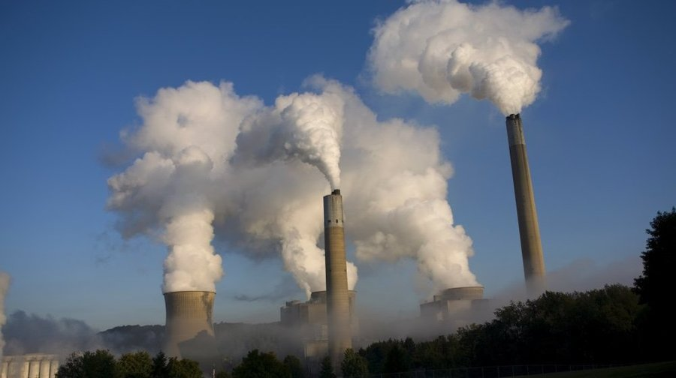
Energy
Energy and the Environment
Fossil fuels produce increased levels of greenhouse gases which could cause global warming.
Nuclear fuels produce radioactive waste.
Renewable energy resources will never run out, they don’t produce harmful waste products (greenhouse gases or radioactive waste) and they can be used in remote places. But they cover large areas and they can disturb natural habitats.
Different energy resources can be evaluated in terms of reliability, environmental effects, pollution and waste.

Slide 15
Energy
Big Energy Issues
Gas-fired power stations and pumped-storage stations can meet variations in demand.
Nuclear power stations are expensive to build, run and decommission.
Carbon capture of fossil fuel emissions is likely to be expensive.
Renewable resources are cheap to run but expensive to install.
Nuclear power stations, fossil-fuel power stations that use carbon capture technology, and renewable energy resources are all likely to be needed for future energy supplies.

Slide 16
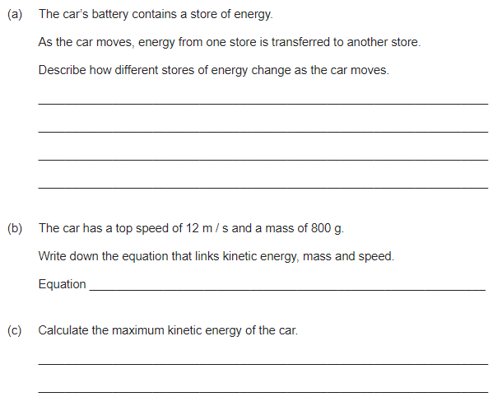
Energy – Exam practice
Notes:
(a) the store of chemical energy (in the battery) decreases
1
the internal energy of the surrounding air increases.
1
accept description of energy becoming less usefully stored for 2marks
(b) kinetic energy = ½ mass × velocity²
1
(c) E_{K} = ½ × 0.8 × 12²
1
E_{K} = 57.6 (J)
1
allow 57.6 (J) without working shown for 2 marks

Slide 17
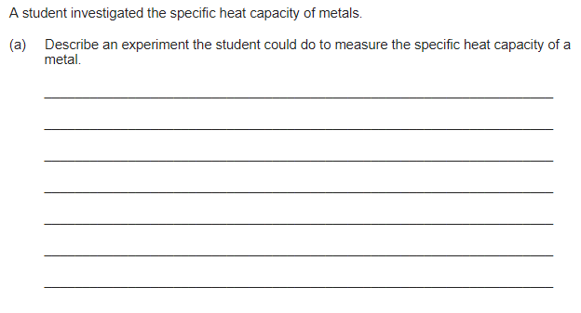
Energy – Exam practice
Notes:
(a) Level 3 (5–6 marks):
A full, detailed and coherent plan covering all the major steps is provided, which outlines what needs to be measured to calculate specific heat capacity. The steps are set out
in a logical manner that could be followed by another person to calculate the specific
heat capacity.
Level 2 (3–4 marks):
The substantive content of a plan is present but may be missing some steps. The plan
may not be in a completely logical sequence but leads towards the calculation of the
specific heat capacity.
Level 1 (1–2 marks):
Simple statements relating to relevant apparatus or steps are made but they may not be
in a logical order. The plan would not allow another person to calculate specific heat capacity.
0 marks:
No relevant content.
Indicative content
• measure the mass of metal
• correct use of balance
• description of how work is done or energy transferred to metal
eg electrical work, mechanical work (eg dropping lead shot)
• how energy transfer or work done is measured
eg electrical using joulemeter, mechanical decrease in potential energy store of falling lead shot
• equate work done / energy transferred = increase in thermal energy store of the
metal
• calculate specific heat capacity

Slide 18
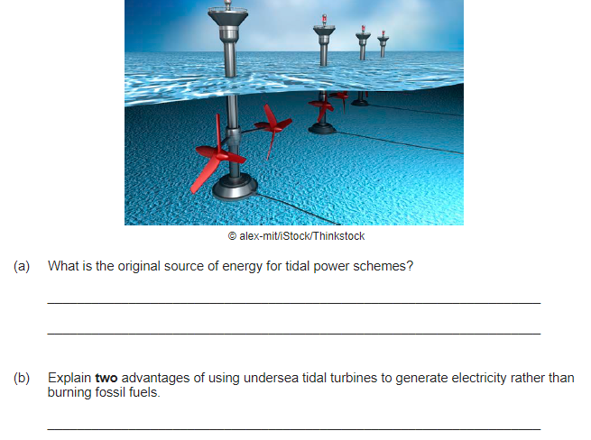
Energy – Exam practice
Notes:
(a) gravity (of moon and sun)
1
(b) any two from:
1 mark for statement, 1 mark for correctly linked reason
• tidal energy is renewable (1)
• so won’t run out like fossil fuels (1)
or
• doesn’t emit carbon dioxide
• so won’t contribute to global warming / climate change
or
• doesn’t emit oxides of sulfur or nitrogen
• so doesn’t cause acid rain
or
• doesn’t use fossil fuels
• so less impact on environment of extraction / transport
or
• doesn’t produce particulates
• so less effect on health / environment

Slide 19

Energy – Exam practice
Notes:
(a) (i) 150
1
(ii) transferred to the surroundings by heating
reference to sound negates mark
1
(iii) 0.75
450 / 600 gains 1 mark
accept 75% for 2 marks
maximum of 1 mark awarded if a unit is given
2
(iv) 20 (s)
correct answer with or without working gains 2 marks
correct substitution of 600 / 30 gains 1 mark

Slide 20
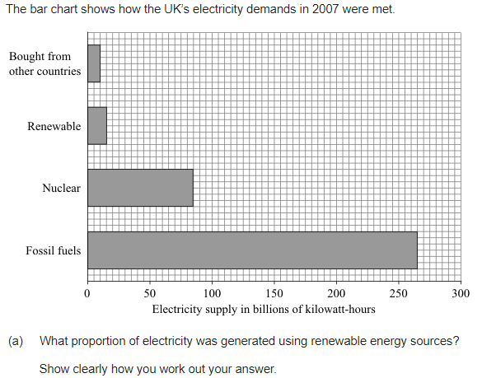
Energy – Exam practice
Notes:
(a) 1/25 or 1:25 or 0.04
accept 4 % or or 1 in 25 for both marks
allow 1 mark for total of 375
allow 1 mark for a clearly correct method using a clearly incorrect total
do not accept 1:26

Slide 21
How do I review my learning on Electricity?
Do Now Activity
Last Week: What is Power, state all equations used to measure power [ROTOE] | Last Term: What is electrical charge? State the equation [ROFOEC]
Last Year: What is the job of a step up and step down transformer?
Notes:
Science

Slide 22
Electricity
Current and circuit symbols
Resistance and V=IR
Resistance and I-V characteristics
Circuit devices
Series circuits
Parallel circuits
Investigating resistance
Electricity in the home
Power of appliances
Power
The national grid

Slide 23
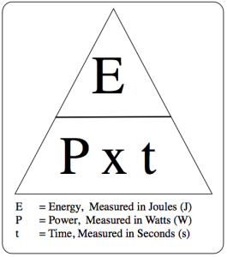
Electricity
Electrical Appliances
Electricity and gas and/or oil supply most of the energy you use in your home.
Electrical appliances can transfer energy in the form of useful energy at the flick of a switch.
Uses of everyday electrical appliances include heating, lighting, making objects move (using an electric motor) and producing sound and visual images.
An electrical appliance is designed for a particular purpose and should waste as little energy as possible.
Energy and Power
Power is the rate of transfer of energy.
Power (W) = Energy transferred (J) ÷ Time (s)
Power wasted by an appliance = total power input – useful power output

Slide 24
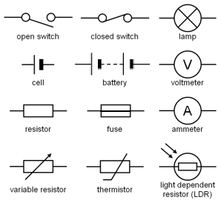
Electricity
Electrical Components
Cell – Pushes electrons around a complete circuit
Battery – Two or more cells connected together
Indicator – Emits light when a current passes through it
Diode – Allows current to flow through in only 1 direction
Ammeter – Used to measure electric current
Fixed resistor – Limits the current in a circuit
Variable resistor – Allows the current to be varied
Fuse – Designed to melt and ‘break’ the circuit if the current gets too high
Heater – Designed to transform electrical energy into heat
Voltmeter – Used to measure the potential difference (voltage)
A circuit diagram shows how the components are connected together

Slide 25
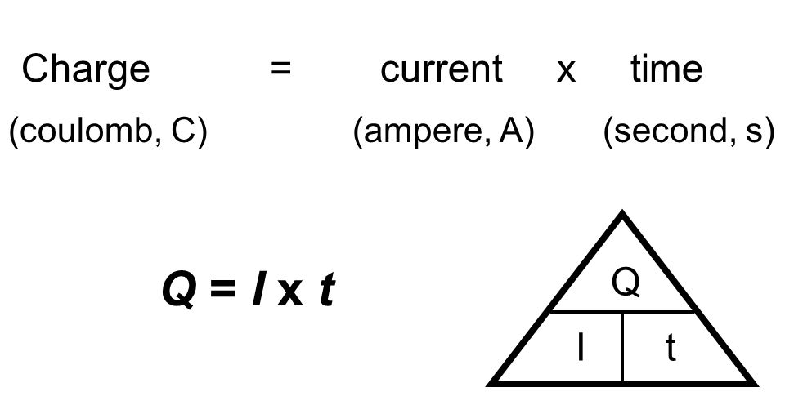
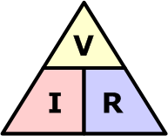
Electricity
Current and Charge
The size of an electric current is the rate of flow of charge.
Charge flow (C) = Current (A) x Time (s)
Potential Difference and Resistance
Potential difference (V) = energy transferred (J) ÷ charge (C)
Resistance (Ω) = potential difference (V) ÷ Current (A)
Ohm’s law states that the current through a resistor at constant temperature is directly proportional to the potential difference across the resistor.
Reversing the potential difference across a resistor reverses the current through it.
RP

Slide 26
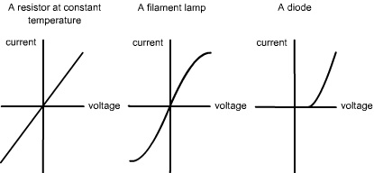
Electricity
Component Characteristics
Filament lamp – Resistance increases if the filament’s temperature increases.
Diode – Forward resistance is low, reverse resistance is high.
Thermistor – Resistance decreases if its temperature increases.
LDR – Resistance decreases if the light intensity on it increases.

Slide 27
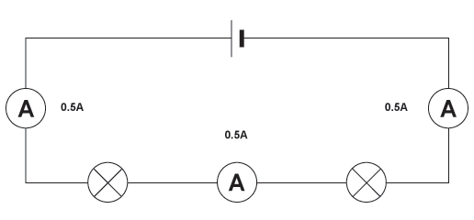
Electricity
Series Circuits
For components in series:
The current is the same in each component
The total potential difference is shared between the components
Adding their resistances gives the total resistance
For cells in series, acting in the same direction, the total potential difference is the sum of their individual potential differences.
Adding more resistors in series increases the total resistance because the current through the resistors is reduced and the total potential difference across them is unchanged.

Slide 28
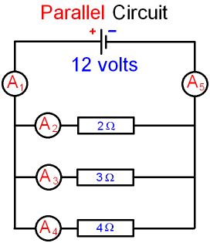
Electricity
Parallel Circuits
For components in parallel:
The total current is the sum of the currents through the separate components
The potential difference across each component is the same
The bigger the resistance of a component, the smaller the current that will pass through that component.
Adding more resistors in parallel decreases the total resistance because the total current through the resistors is increased and the total potential difference across them is unchanged.

Slide 29
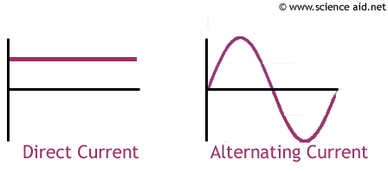
Electricity
Alternating Current
Direct current (d.c.) flows in one direction only.
Alternating current (a.c.) repeatedly reverses its direction of flow.
A mains circuit has a live wire which is alternately positive and negative every cycle, and a neutral wire at zero volts.
The peak potential difference of an a.c. supply is the maximum voltage measured from zero volts.
The frequency of the UK mains supply is 50Hz.
The voltage of the UK mains supply is 230V.

Slide 30
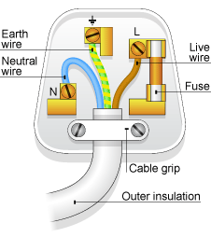
Electricity
Cables and Plugs
Sockets and plug cases are made of stiff plastic materials that enclose the electrical connections. Plastic is used because it is a good electrical insulator.
A mains cable is made up of 2 or 3 insulated copper wires surrounded by an outer layer of flexible plastic material.
In a 3-pin plug or a 3-core cable, the live wire is brown, the neutral wire is blue and the earth wire is green and yellow.
The earth wire is connected to the longest pin in a plug and is used to earth the metal case of a mains appliance.
Electrical Power
The power supplied to a device is the energy transferred to it each second.
Energy transferred (J) = Power (W) x time (s)
Power (W) = Current (A) x Potential difference (V)

Slide 31
Electricity
Electrical Currents and Energy Transfer
Charge flow (C) = Current (A) x Time (s)
When charge flows through a resistor, energy transferred to the resistor makes it hot.
Energy transferred (J) = Potential difference (V) x Charge flow (C)
When charge flows around a circuit for a given time, the energy supplied by the battery is equal to the energy transferred to all the components in the circuit.
Appliances and Efficiency
A domestic electricity meter measures how much energy is supplied.
Energy transferred (J) = Power (W) x Time (s)
Useful energy used = efficiency x energy supplied

Slide 32
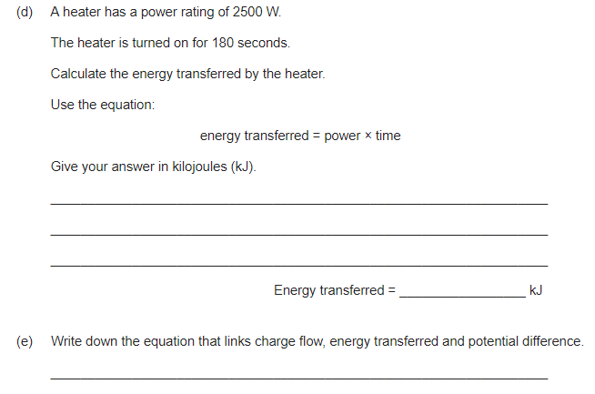
Electricity – Exam practice
Notes:
(d) energy = 2500 × 180
1
= 450 000
1
= 450 kJ
1
allow 450 with no working shown for 3 marks
(e) energy transferred = charge flow × potential difference
allow E = QV

Slide 33
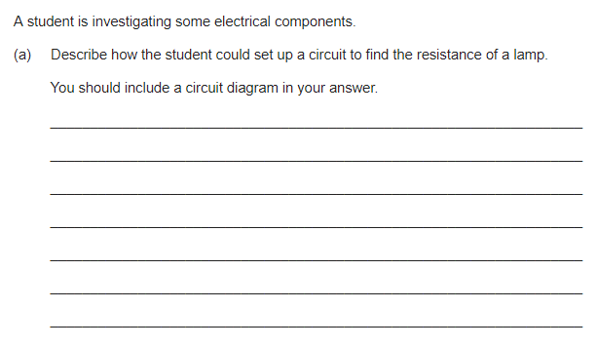
Electricity – Exam practice
Notes:
(a)
ammeter connected in series
1
voltmeter connected in parallel
1
measure the potential difference across the lamp at known current
1
calculate resistance from measured values using V = IR

Slide 34
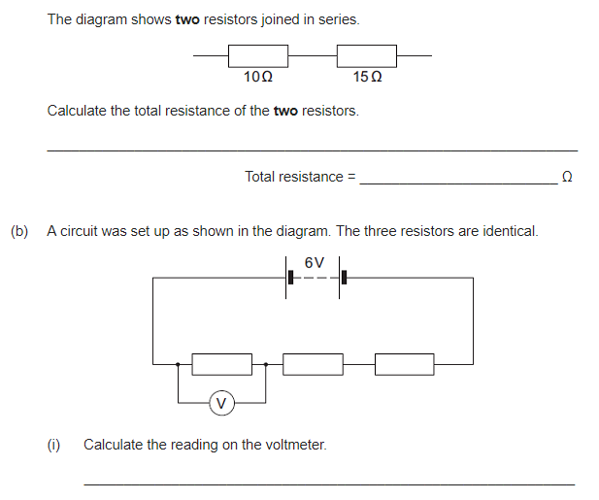
Electricity – Exam practice
Notes:
(a) 25(Ω)
1
(b) (i) 2(V)
allow 1 mark for showing a correct method, ie 6 / 3

Slide 35
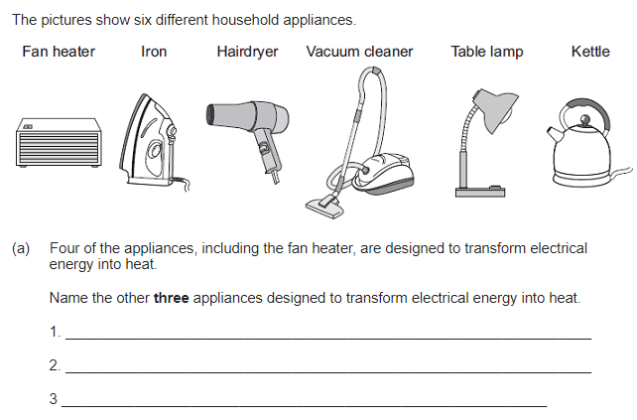
Electricity – Exam practice
Notes:
(a) iron
1
hairdryer
1
kettle
1
answers can be in any order

Slide 36
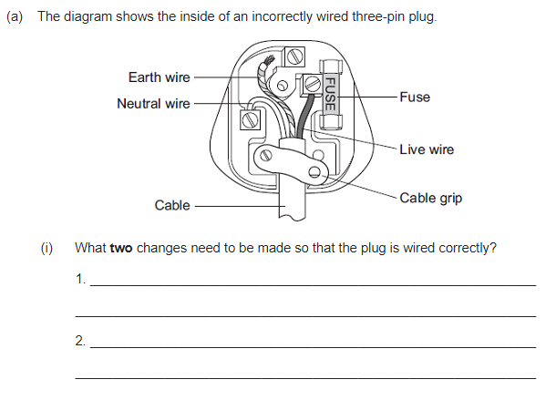
Electricity – Exam practice
Notes:
(a) (i) connect the earth wire (to pin)
answers must be in terms of correcting the faults
1
screw cable grip (across cable)
accept tighten the cable grip

Slide 37
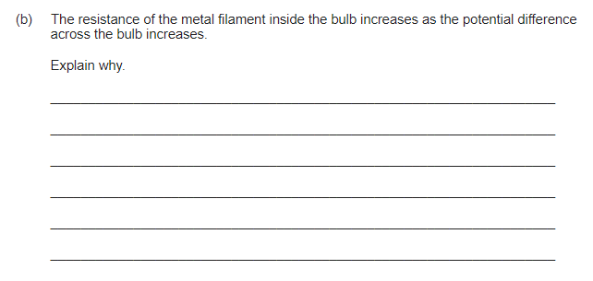
Electricity – Exam practice
Notes:
(b) metals contain free electrons (and ions)
accept mobile for free
1
as temperature of filament increases ions vibrate faster /
with a bigger amplitude
accept atoms for ions
accept ions/atoms gain energy
accept vibrate more for vibrate faster
do not accept start to vibrate
1
electrons collide more (frequently) with the ions
or
(drift) velocity of electrons decreases
do not accept start to collide
accept increasing the p.d. increases the temperature (1 mark)
and
(and) resistance increases with temperature (1 mark) if no other marks scored

Slide 38
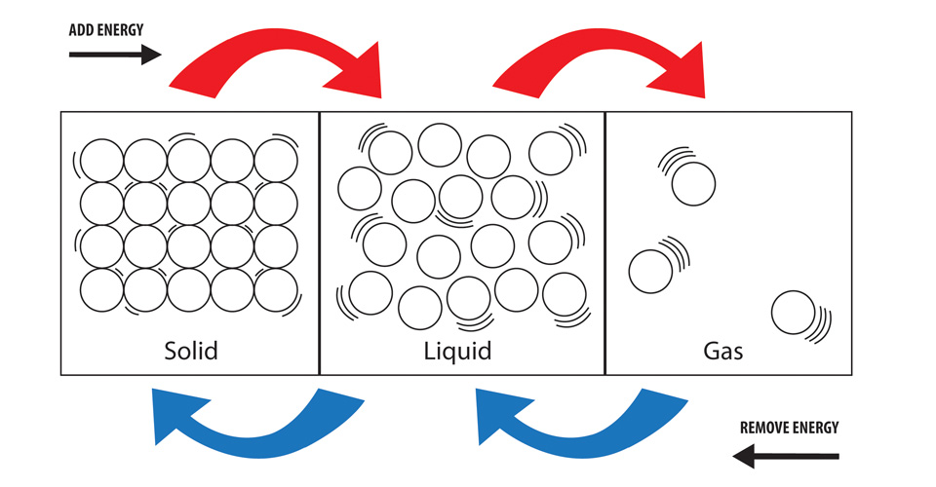
Particle model of matter
The particle model and motion in gases
Density of materials
Internal energy and changes of state
Specific latent heat

Slide 39
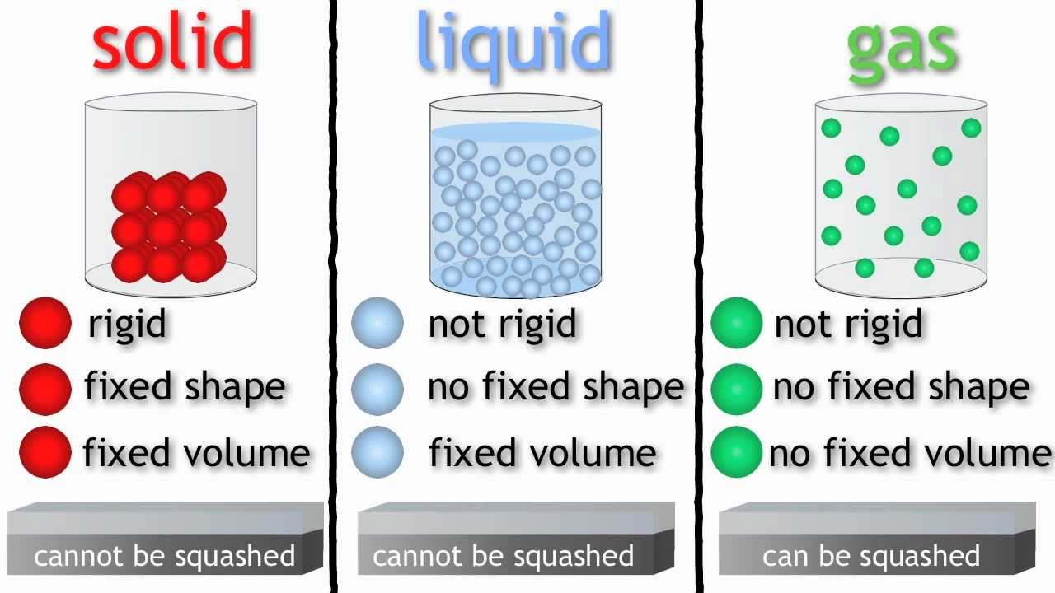
Particle model of matter
Density
Density (kg/m²) = mass (kg) ÷ volume (m²)
The density of a substance is defined as its mass per unit volume.
Objects that have a lower density than water (i.e. <1000kg/m²) float in water.
States of Matter
Solids – particles are held next to each other in fixed positions. Least energetic state.
Liquids – Particles move about at random and are in contact with each other. More energetic than solids, but less energetic than gases.
Gases – Particles move about randomly and are far apart. They are much less dense than solids and liquids. Most energetic state.
When a substance changes state, its mass stays the same because the number of particles stays the same.
RP

Slide 40
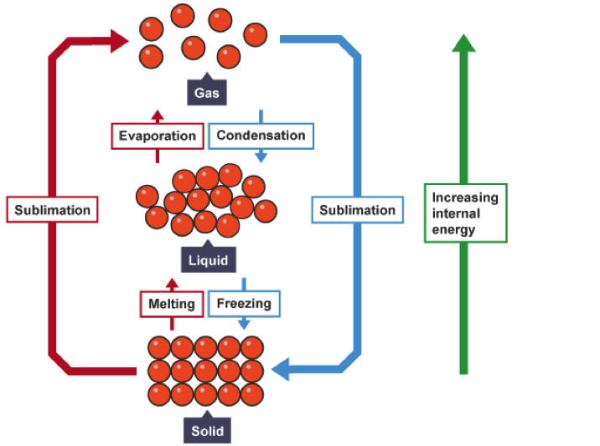
Particle model of matter
Changes of State
For a pure substance:
Its melting point is the temperature at which it melts (which is the same temperature at which it solidifies)
Its boiling point is the temperature at which it boils (which is the same temperature at which it condenses).
Energy is needed to melt a solid or to boil a liquid.
Boiling occurs throughout a liquid at its boiling point.
Evaporation occurs from the surface of a liquid when its temperature is below its boiling point.
The flat section of a temperature-time graph gives the melting point or boiling point of a substance.

Slide 41
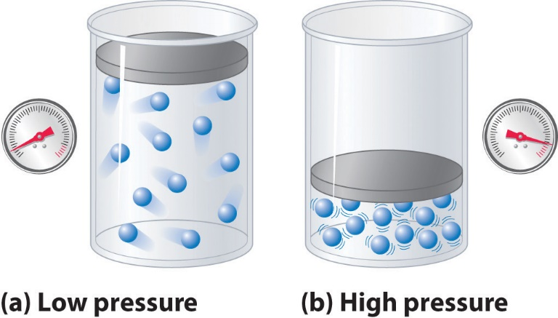
Particle model of matter
Internal Energy
Increasing the temperature of a substance increases its internal energy.
The strength of the forces of attraction between the particles of a substance explains why it is a solid, liquid or a gas.
When a substance is heated:
If its temperature rises, the kinetic energy of its particles increases
If it melts or boils, the potential energy of its particles increases.
The pressure of a gas on a surface is caused by the particles of the gas repeatedly hitting the surface.

Slide 42
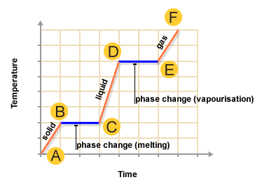
Particle model of matter
Specific Latent Heat
Latent heat is the energy needed for a substance to change its state without changing its temperature.
Specific latent heat of fusion (or of vaporisation) is the energy needed to melt (or to boil) 1kg of a substance without changing its temperature.
Energy (J) = Mass (kg) ÷ Specific latent heat (J/kg)
The specific latent heat of ice (or water) can be measured using a low-voltage heater to melt the ice (or boil the water).

Slide 43
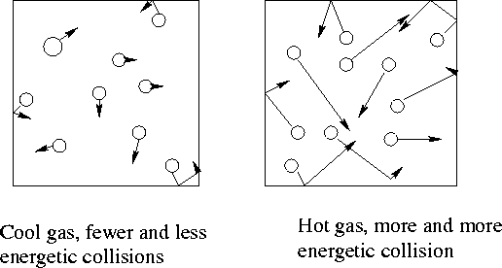
Particle model of matter
Gas Pressure and Temperature
The pressure of a gas is caused by the random impacts of gas molecules on surfaces that are in contact with the gas.
If the temperature of a gas in a sealed container is increased, the pressure of the gas increases because:
The molecules move faster so they hit the surfaces with more force
The number of impacts per second of gas molecules on the surfaces of a sealed container increases, so the total force of the impacts increases.
The unpredictable motion of smoke particles is evidence of the random motion of gas molecules.

Slide 44
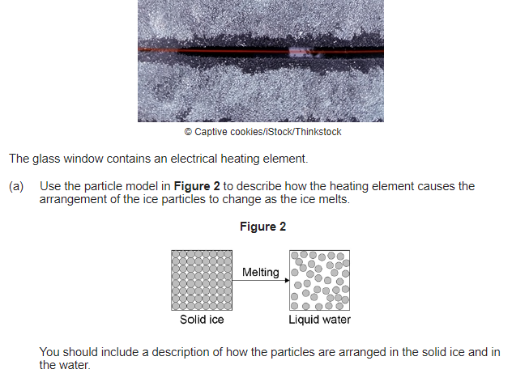
Particle model of matter – Exam practice
Notes:
(a) Level 3 (5–6 marks):
A clear, logical explanation containing accurate ideas presented in the correct order with links between ideas.
Level 2 (3–4 marks):
Key ideas presented with some linked together to form a partial explanation.
Level 1 (1–2 marks):
Fragmented ideas, some may be relevant, insufficient links to form an explanation.
0 marks:
No relevant content.
Indicative content
• current in the wire causes heating
• increases temperature of the metal wires / ice
Solid
• arrangement of particles is regular
• particles vibrate about a fixed position
Melting
• internal energy of the ice increases, increasing the temperature to melting
point
• so (as the temperature increases) particles vibrate faster
• eventually particles vibrate fast enough to break free from the (strong) bonds
• therefore the arrangement of particles becomes irregular
Liquid
• arrangement of particles is irregular
• particles movement (translational) is random

Slide 45
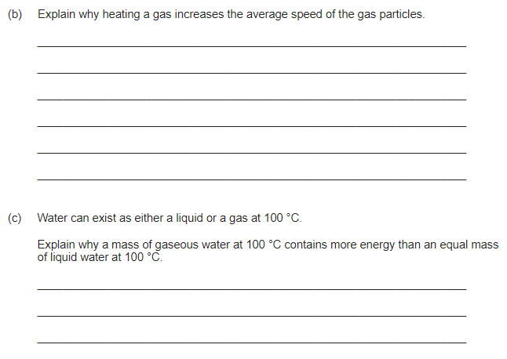
Particle model of matter – Exam practice
Notes:
(b) heating increases the temperature of the gas
1
temperature is proportional to kinetic energy
1
if kinetic energy increases speed increases
1
(c) energy is needed to change the state of the water
1
to break the bonds

Slide 46
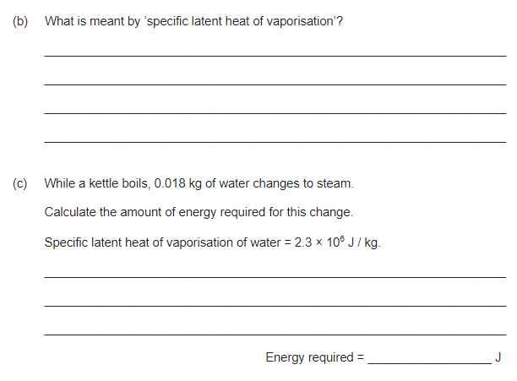
Particle model of matter – Exam practice
Notes:
(b) amount of energy required to change the state of a substance from liquid to gas (vapour)
1
unit mass / 1 kg
dependent on first marking point
1
(c) 41000 or 4.1 × 10⁴ (J)
accept
41400 or 4.14 × 10⁴
correct substitution of
0.018 × 2.3 × 10⁶ gains 1 mark

Slide 47
How do I review my learning on Radioactivity?
Do Now Activity
Last Week: What are the sub-atomic particles, their charges and masses? | Last Term: Why is graphite soft and slippery?
Last Year: Draw the structure of Magnesium Oxide [MgO] ?
Notes:
Science

Slide 48
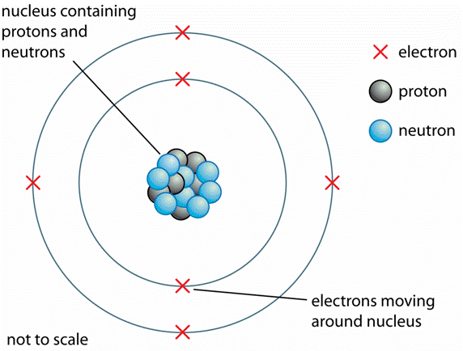
Atomic structure
Developing the model of the atom
Isotopes and nuclear radiation
Nuclear equations
Half life
Irradiation and contamination

Slide 49
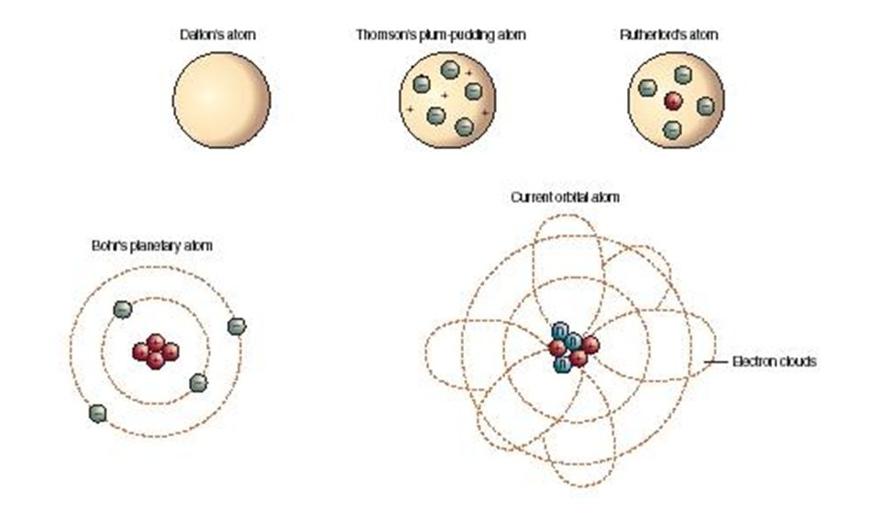
Atomic structure
Atoms and Radiation
A radioactive substance contains unstable nuclei that become stable by emitting radiation.
Radioactive decay is a random event. It can’t be predicted or influenced.
Radioactive sources emit alpha (α), beta (β) and gamma (γ) radiation.
The Discovery of the Nucleus
Rutherford used α particles to probe inside atoms. He found that some of the α particles were scattered through large angles.
The ‘plum pudding’ model couldn’t explain this observation.
An atom has a small positively charged central nucleus where most of the atom’s mass is located.
The nuclear model of the atom explained Rutherford’s observations.

Slide 50
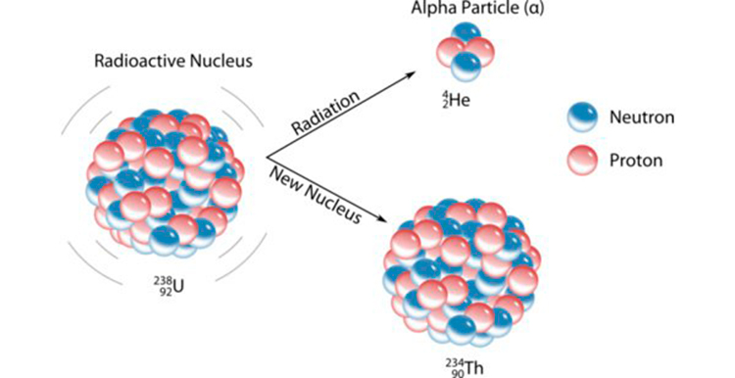
Atomic structure
Changes in the Nucleus
Isotopes of an element are atoms with the same number of protons but different numbers of neutrons. They have the same atomic number but different mass numbers.
Alpha, beta and gamma radiation ionise substances they pass through.
Ionisation in a living cell can damage or kill the cell.
Alpha Particles
Nucleus loses 2 protons and 2 neutrons
2 protons and 2 neutrons are emitted as an α particle
Atomic mass decreases by 4 after α particle emitted
Proton number decreases by 2 after α particle emitted
Greatest ionising power of the 3 types of radioactivity
α radiation is stopped by paper
α radiation can only travel a few cm in air.

Slide 51
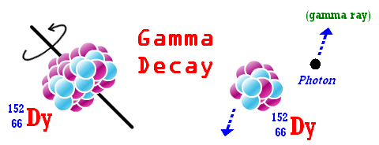
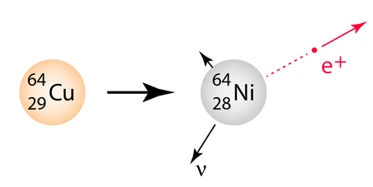
Atomic structure
Beta Decay
A neutron in the nucleus changes into a proton
An electron is created in the nucleus and instantly emitted.
Atomic mass stays the same after β decay
Proton number increases by 1 after β decay
β radiation is stopped by a thin sheet of metal
Has a range of about 1m in air.
Less ionising than alpha radiation but more ionising than gamma
Gamma Radiation
Consists of electromagnetic radiation
Stopped by thick lead.
Unlimited range in air

Slide 52
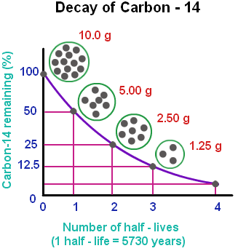
Atomic structure
Activity and Half-life
The half-life of a radioactive isotope is the average time it takes for the number of nuclei of the isotope in a sample to halve.
The count rate of a Geiger counter caused by a radioactive source decreases as the activity of the source decreases.
The number of atoms of a radioactive isotope and the count rate both decrease by half every half-life.
The count rate after n half-lives = the initial count rate ÷ 2^{n}

Slide 53
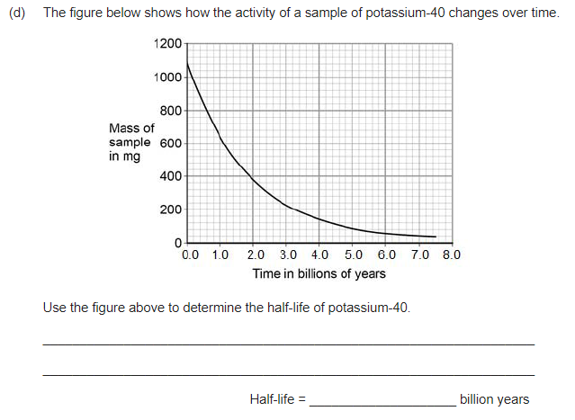
Atomic structure – Exam practice
Notes:
(d) 1.3 (billion years)
allow 1.2-1.4 (billion years)
2
allow 1 mark for horizontal line drawn from ~ 550

Slide 54
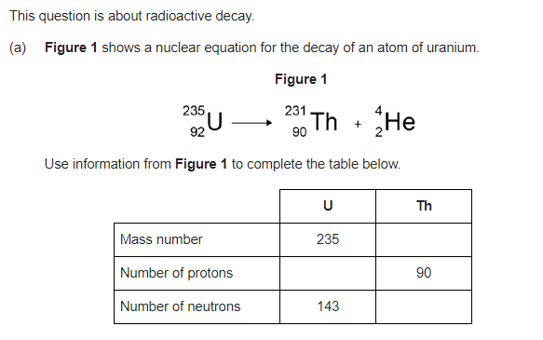
Atomic structure – Exam practice
Notes:
(a) (mass number) 231
1
(protons) 92
1
(neutrons) 141

Slide 55
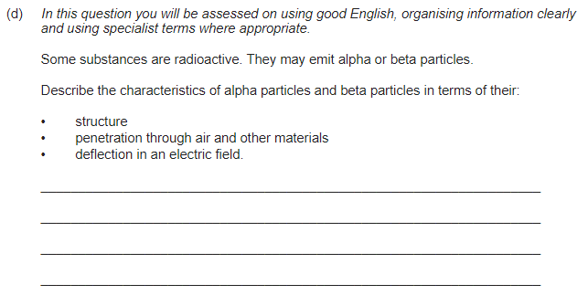
Atomic structure – Exam practice
Notes:
(d) Marks awarded for this answer will be determined by the quality of communication as well as the standard of the scientific response. Examiners should apply a best-fit approach to the marking.
0 marks
No relevant content
Level 1 (1 – 2 marks)
There is a basic description of at least one of the particles in terms of its characteristics.
Level 2 (3 – 4 marks)
There is a clear description of the characteristics of both particles
or
a full description of either alpha or beta particles in terms of their characteristics.
Level 3 (5 – 6 marks)
There is a clear and detailed description of both alpha and beta particles in terms of their characteristics.
examples of the physics points made in the response:
structure
• alpha particle consists of a helium nucleus
• alpha particle consists of 2 protons and 2 neutrons
• a beta particle is an electron
• a beta particle comes from the nucleus
penetration
• alpha particles are very poorly penetrating
• alpha particles can penetrate a few cm in air
• alpha particles are absorbed by skin
• alpha particles are absorbed by thin paper
• beta particles can penetrate several metres of air
• beta particles can pass through thin metal plate / foil
• beta particles can travel further than alpha particles in air
• beta particles can travel further than alpha particles in materials eg metals
deflection
• alpha particles and beta particles are deflected in opposite directions in an electric field
• beta particles are deflected more than alpha particles
• alpha particles have a greater charge than beta particles but beta particles have much less mass
or
beta particles have a greater specific charge than alpha particles

Slide 56
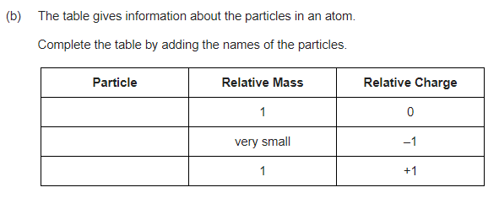
Atomic structure – Exam practice
Notes:
(b) neutron
all 3 in correct order
electron
allow 1 mark for 1 correct
proton

Slide 57
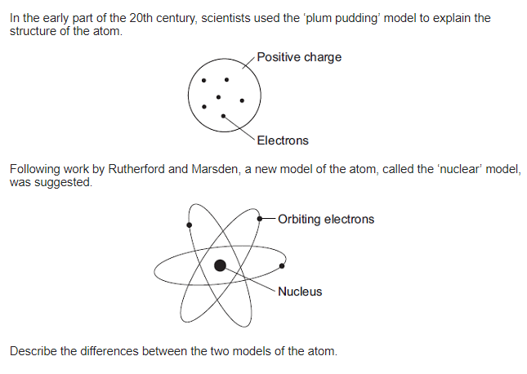
Atomic structure – Exam practice
Notes:
any two pairs from:
to gain credit it must be clear which model is being described
do not accept simple descriptions of the diagram without comparison
• nuclear model mass is concentrated at the centre / nucleus (1)
accept the nuclear model has a nucleus / the plum pudding model does not have a nucleus for 1 mark
plum pudding model mass is evenly distributed (1)
• nuclear model positive charge occupies only a small part of the atom (1)
plum pudding model positive charge spread throughout the atom (1)
• nuclear model electrons orbit some distance from the centre (1)
accept electrons in shells / orbits provided a valid comparison is made with the plum pudding model
plum pudding electrons embedded in the (mass) of positive (charge) (1)
do not accept electrons at edge of plum pudding
• nuclear model the atom mainly empty space (1)
plum pudding model is a ‘solid’ mass (1)

