Slide 1
PE Kit
The Academy has strict guidelines on dress and all pupils are expected to wear the full Academy uniform. The PE kit for all years is detailed below:
Academy short-sleeved sports polo kit
Academy long-sleeved reversible sports shirt
Academy shorts
Plain black sports socks
Suitable lace up trainers
In addition, pupils can choose to wear the Academy tracksuit bottoms
Plain black tracksuit bottoms/leggings/long plain black tops (no zips or logos ) can be worn under shorts/tops as normal, or normal school black tracksuits.
Blazers or school jumpers will be allowed if it is cold but we may adapt the games for this to make it safe.

Slide 2
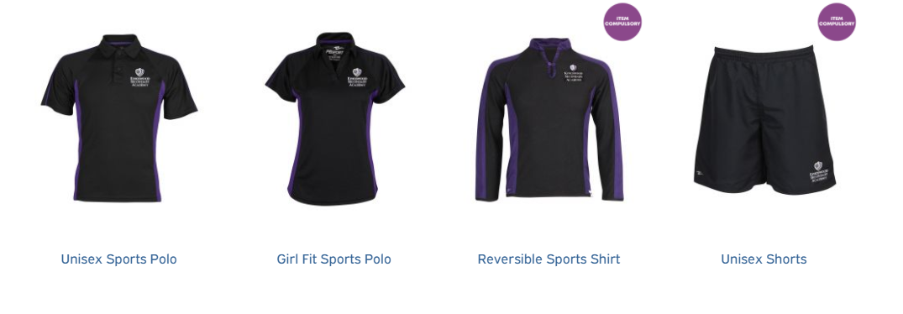
If kit is on order then plain black T-shirts and tracksuit bottoms will be allowed - a note must be brought from home to confirm this. Leggings can only be worn under the shorts.

Slide 3
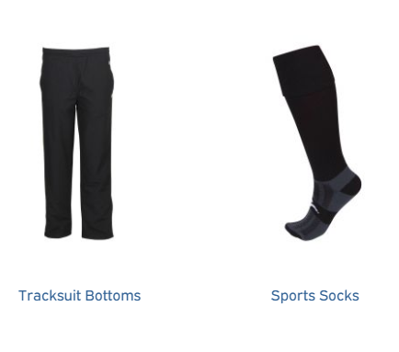
In the present situation pupils can wear school jumpers or blazers for PE but pupils must realise that lessons will be adapted if this happens due to risk assessments.
No other tops are allowed (inc black hoodies) - if pupils are cold on the way to school they should wear a coat or top that they remove when they enter the school.

Slide 4

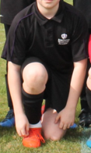
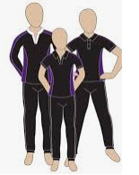

Slide 5
Moving forward
A group of Kingswood pupils did meet with our kit suppliers to look at items we intend to add to the PE kit. The following items were planned to be part of the kit but due to COVID have been delayed as they have not had sufficient supplies:
A more modern fit tracksuit bottom.
Sport leggings that do not need to go under shorts.
A sports top for warmth.

Slide 6
Finally
For those of you who have been issued with a Kingswood sports hoodie (sports leaders etc) you may wear this to and from school.
However, it is not to be worn in class and if you are cold, then you should wear your Kingswood blazer or purple / black Kingswood jumper.

