Slide 1


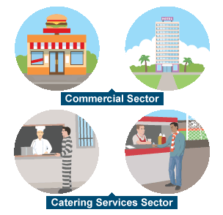
















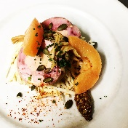




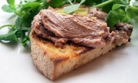
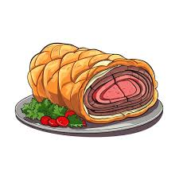










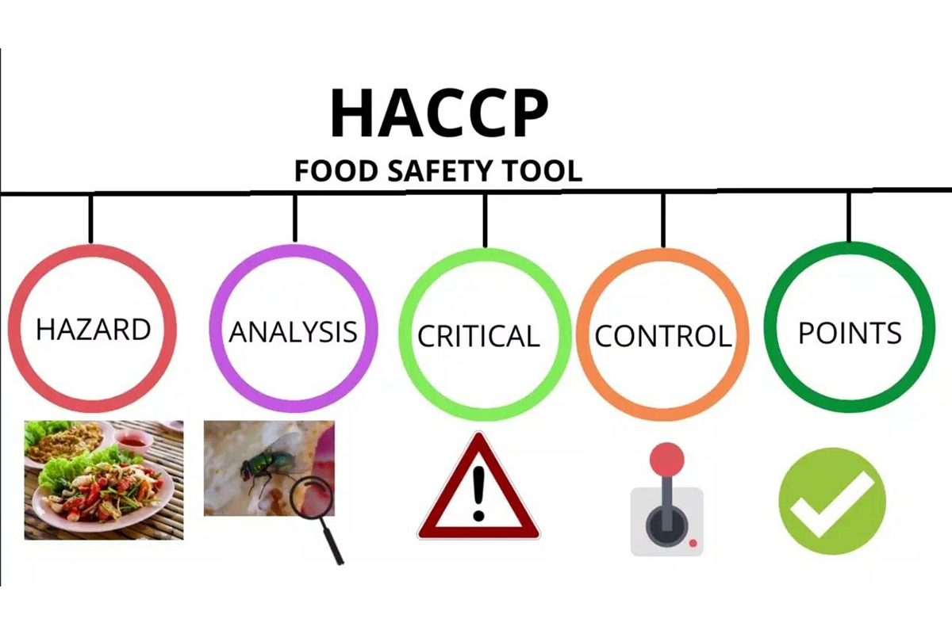




WJEC Hospitality and Catering Learning Journey
3.4
June 26 May 26
Unit 2 Assessment Deadline End of April
March 26- Feb 26
Next Steps
Unit 1 (40%) Written Paper
Real
Hospitality and Catering Providers
The Hospitality and Catering Industry
September 25 October 25
Nov 25
December 25 – Jan 26
Health and Safety
Customer Requirements
Skills Cooks
Bread Making
PPE/ Mock
Written Paper
Unit 2 Assessment real Cooking 3 to 4 hours (60%)
Food Safety
Environmental Health
Front vs Back of House
Menu Planning
Unit 2 Assessment real start (60%)
July 25 June 25
March 2025 – February 2025
Health and Safety
3.4
YEAR
Customer Requirements
11
Practical Cooks e.g
Starter: Vegetable Samoseas and Tomato Chutney
Main: Chicken Ballantine
Dessert: Custard Tart
PPE/ Mock
Written Paper
Skills Cooks e.g
Custard, Brandy Snaps
Nutrition
December - January 2025
Practical Cooks e.g
Starter: Puff Pastry Tart
Main: Beef Wellington
Dessert: Apple Souffle
Practical Cooks e.g
Main: Ravioli with Garlic Roux Sauce
Dessert: Choux Buns
Menu Planning
Unit 2 Coursework written Assessment mock or real if pupils are ready
Food Safety
Nutrition
November - September 2024
3.4
YEAR
Food Safety
10
3.4
Practical Cooks
Starter: Caramelised Shallot and Mushroom Toast
Main: Poached Salmon and Hollandaise Sauce
Dessert: Chocolate Fondant with Poached Strawberries
Skills Cooks
Vegetable Crisps
Key Stage 3
Food Related Ill Health
Baseline
Assessment

