Slide 1


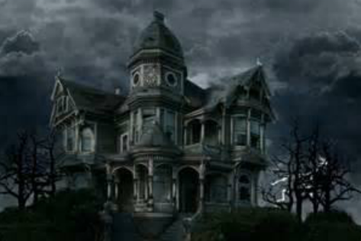

KEY STAGE 3
Drama and Dance
AUTUMN TERM Term 1 & 2
Topic one and two is Matthew Bourne. Nutcracker
YEAR 7
Dance and Drama
Cannon, performance, duets, motif and development
Pupils follow all the topics over the year.
SPRING TERM Term 3 and 4
Topic 3 Darkwood Manor
Topic 4 Darkwood Manor
Choreography, professional repertoire, appreciation, production element
SUMMER TERM
5 and 6
Topic 5 is Graffiti/Choreographic devices
Topic 6 is Wacky Soap, social drama – Mark Wheeller
Cannon, performance, duets, motif and development

Slide 2
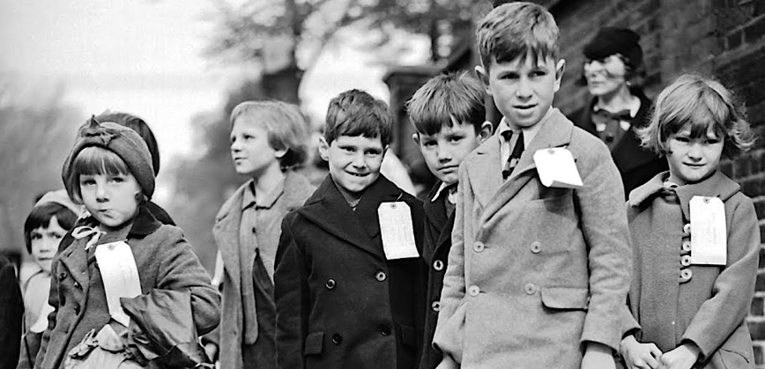
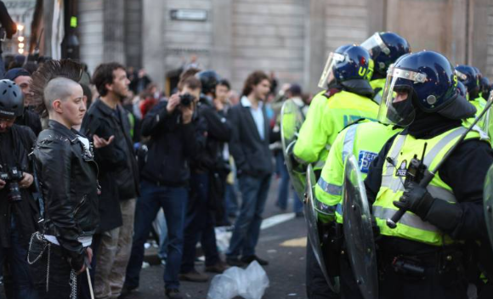
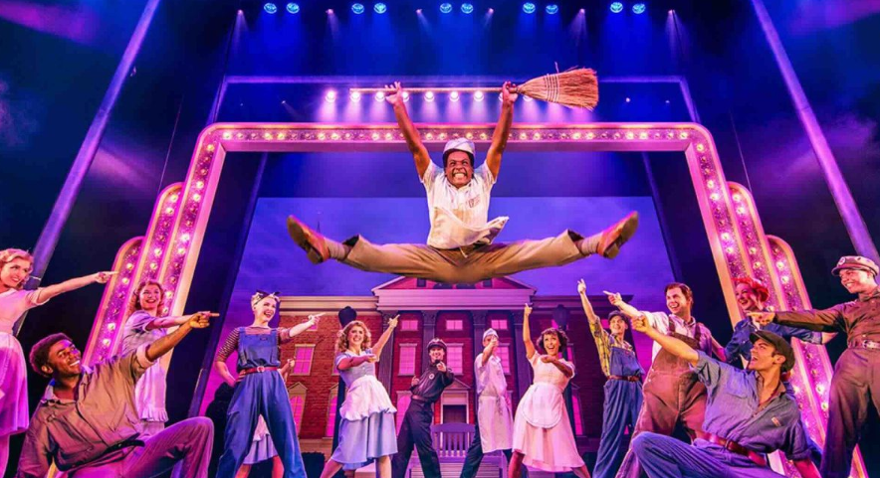
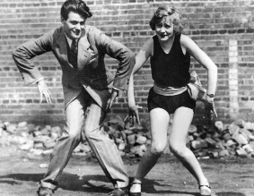
KEY STAGE 3
Drama and Dance
AUTUMN TERM 1 and 2
Topic one is Evacuees/War
Topic two is London Riots/Conflict
YEAR 8
Dance and Drama
Pupils follow both dance and drama over the year
Cannon, performance,
duets, motif and development
SPRING TERM 1
SPRING TERM 2
Topic 4 is Swansong
Topic 3 is Introduction to practitioners naturalism/realism Stanislavski.
SUMMER TERM 1 & 2
Topic 6 is Dance through times 1920's and now
Topic 5 is musicals throughout time

Slide 3

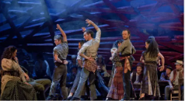
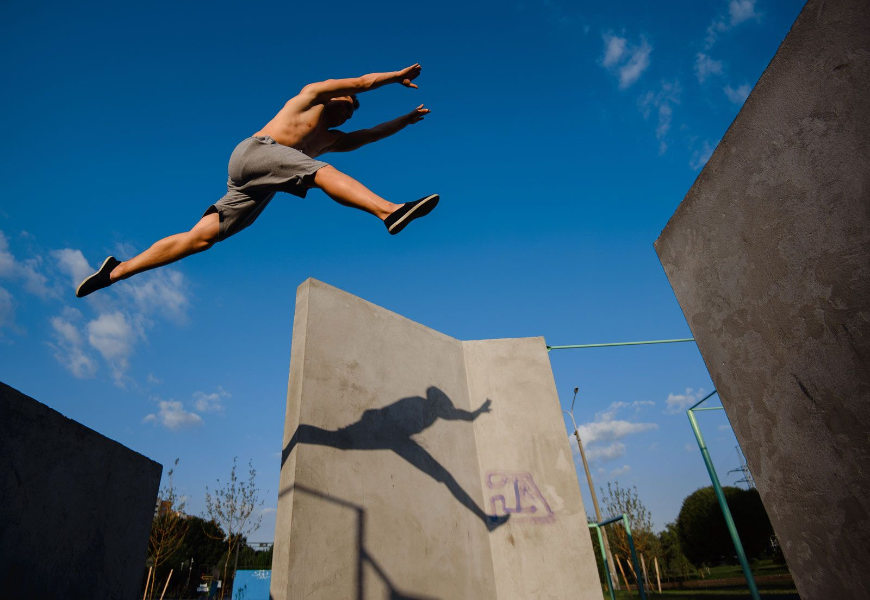
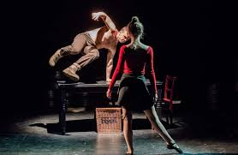

KEY STAGE 3
Drama and Dance
AUTUMN TERM 1 & 2
Topic one is Blood Brothers Drama
YEAR 9
Topic 2 Carmen Dance
Dance and Drama
Script work
Pupils follow all topics over the year in Dance and Drama.
Social, historical and Cultural aspects
SPRING TERM 1 & 2
Topic 3 is Drama Physical theatre
Topic 4 is Parkour (Dance)
SUMMER TERM 1 & 2
Topic 5
Devising and Choregraphing
Topic 6 is Live Theatre review
You only pick one pathway either Dance or Drama – you can do both if you really to but it will take two options and you need to speak to a member of staff before you choose both.
BTEC in Performing Arts through Drama or Dance.

Slide 4
Introduction to physical/interpretive skills
Develop skills and techniques for performance
Apply and review skills and techniques for performance Two styles: Street and Contemporary.
Sep - Oct
Yr 10
Nov - Dec
Jan -April
Dance/Drama
2019-2022
Understand how to respond to a brief, select, apply and review skills and techniques
Examine practitioners' performance work and explore relationships
.
May-Jul
Nov-Dec
Sep- Oct
Jan - April
Options
PPE ??
Explore the use of physical skills and interpretive skills. Component 2
Resit
May-July
???
Examine practitioners' performance work and explore relationships.
Understand how to respond to a brief, select, apply and review skills and techniques
Sep- Dec
Jan -April

Slide 5
BTEC Performing
Arts LEVEL 2
Understanding Acting Skills
Develop skills and techniques for strength, stamina and flexibility.
Apply and review skills and techniques for performance.
Sep - Oct
Drama Yr 11
Nov - Dec
Jan -April
Drama 10 years
2019-2022
Show.
Induction
Application of skills in Settings
Devising Skills
May-Jul
Sep- Oct
Nov-Dec
Yr 10
Jan - April
PPE ??
Understand how to respond to a brief, select and apply skills
Resit
April - May
Yr 11
How to review skills and techniques
PPE ?
Examine practitioners' performance work and explore relationships.
Understand how to respond to a brief, select, apply and review skills and techniques
June- July
Sep- Dec
Jan -April

Slide 6
BTEC Performing
Arts LEVEL 3
Investigating contextual factors that influence work of performing arts practitioners.
Understand, develop, apply and review acting styles and techniques
Sep - Oct
Year 12
Nov - Dec
Jan -April
Dance and Drama
2019-2021
May-Jul
Year 13
Jan - April
PPE ??
Sep- Oct
Nov-Dec
Exam
May-July
???
Sep- Dec
Jan -April

