Slide 1
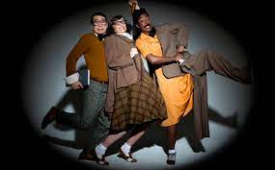
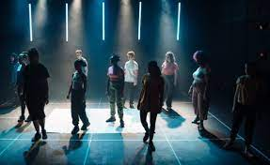



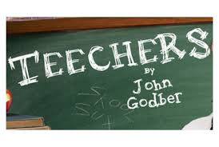

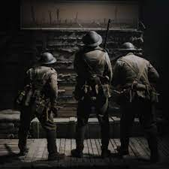


Curriculum Intent
Course content
Ambitious content
Subject Specific Skills
Drama Learning Journey
*Agent * Showreel * Audition * Research * Pitch * Career Progression
Aspiration
Unit 1 Prepare to work in the performing arts sector
Unit 3 Influential Performance practice.
13
CTECH
PERFORMING
ARTS
Client Brief
Forecasting
Budgeting
Health & Safety
Arts Event
Management
Unit 2
Proposal for a commissioning brief
Universal language
*
Mime
*
Physical Theatre
*
Storytelling
12
Unit 4
Combined Arts
Unit 8
Performing Repertoire
Artaud's Theatre of the Absurd
Original devising
Katie Mitchell
Live Cinema Theatre
Verbatim and Political theatre
Multi-Media combined Arts
Responding to a brief;
Devising original drama
C3
11
Performing Repertoire
Role of the Director, Actor and Technician
Script Inference skills and Acting Skill analysis
Script
exploration
Exploring the Performing Arts
Verbatim Theatre
C2
Musical Theatre
‘Everyone’s Talking about Jamie’
C1
‘Broke’
by The Paper Birds
BTEC
PERFORMING
ARTS
Direct Address * Multi-role play * Narration
Thought tracking * Mime * Hot-seating * Split Scene
10
Melodrama
Brecht's Epic Theatre
1980s Politics
Brecht's Epic Theatre
Teechers
By John Godar
Blood Brothers
by Willy Russell
Academic Excellence
Hot-seating
Mime
Flashback
Gothic theatre
Documentary drama
Teacher-in-role
9
8
Meta-Theatre
Darkwood Manor
‘Virtual World’
Helmet by Douglas Maxwell
World War One
The Muddy Choir by Jesse Briton
Direct address
Narration
Sound Collage
Freeze Frames
Contemporary theatre
Surrealism
Ernie's Incredible Illucinations
By Alan Ayckbourn
The Tell-Tale Heart
by Edgar Allen Poe
7
Inference skills
Combined-arts
Physical Theatre
Thought tracking
Episodic structure
Multi-role play
Social responsibility

