Slide 1
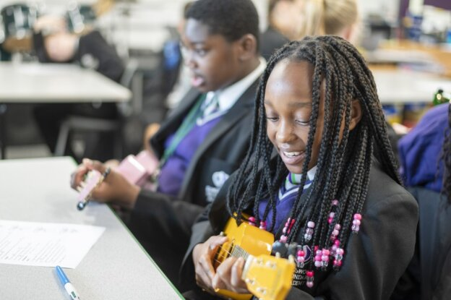


Mr Matt Gamble – Principal
Mrs Alex Bonner- Senior Assistant Principal
Mrs Rhiain O’Malley – Head of Year 7

Slide 2

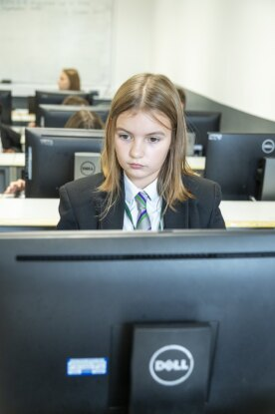
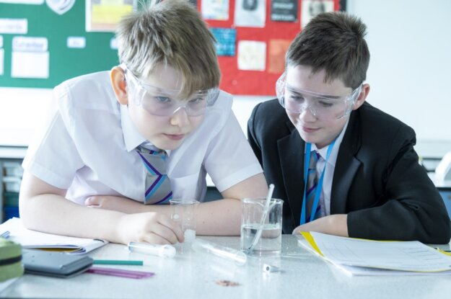
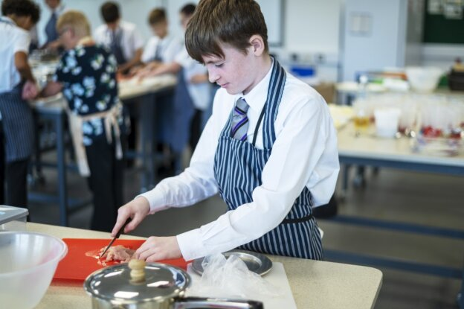
Year 6 Parents’
Induction Evening

Slide 3

Aim:
ABO
  To reassure you and explain our transition process
  To answer any questions you have
  To explain our vision and the expectations you can have of us and we have of our pupils and you as parents
  Meet with our uniform suppliers Price & Buckland
Respect, Independence, Service to the Community, Empathy
Notes:
Alex

Slide 4
Our Vision and Values
MGA
Vision:
We are committed to providing the very best education for all our students irrespective of their ability or background. We seek to ensure that students receive a broad and balanced education that enables them to achieve their potential and take the appropriate next steps in their lives as valued and confident members of society.
Values:
Respect
Independence
Service to the Community
Empathy
Respect, Independence, Service to the Community, Empathy
Notes:
Presenter - MG

Slide 5
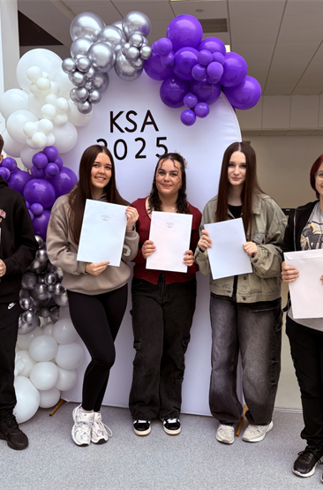

Kingswood is a wonderful place to be educated
Outcomes: Better than national. Best ever which means.
Oversubscribed: Full in every year. More 1st and 2nd choice applications than ever. 431 this year which is up 56% in 3 yrs.
Ofsted:
“Ambition and high expectations underpin the positive and inclusive culture at Kingswood Secondary Academy”
Respect, Independence, Service to the Community, Empathy
Notes:
Presenter - MG

Slide 6
Ofsted – Our Lessons
“pupils study a wide range of subjects… all pupils have the opportunity to take the full range of GCSE courses and the range of academic and vocational courses available in key stage 4 and the sixth form and is well considered to meet pupils’ interests and aspirations”
“Subject curriculums have been designed well… Learning is sequenced carefully so that pupils can link new knowledge to what they already know. This helps pupils to strengthen and deepen their understanding”
“Pupils are encouraged to read, both for pleasure and to enrich their learning across the curriculum. Any pupils who need to develop their reading fluency are supported effectively”
“Teachers have good subject knowledge. They explain concepts clearly and provide pupils with challenging and interesting learning activities”
“The school provides excellent support for pupils with special educational needs and/or disabilities (SEND)”
Respect, Independence, Service to the Community, Empathy
Notes:
MG

Slide 7
Ofsted – Personal Development
“The school’s curriculum is complemented by a rich personal development offer”
“The school provides a variety of extra-curricular activities to support pupils’ wider development. Clubs develop pupils’ talents in sport and the arts. Further opportunities include the Duke of Edinburgh’s Award scheme and the Emergency Services Cadets group”
“Pupils benefit from an excellent careers programme that includes personalised advice about next steps for all pupils and students in the Sixth Form”
Respect, Independence, Service to the Community, Empathy
Notes:
MG

Slide 8
Ofsted – Positive Culture
“There are high expectations of pupils’ behaviour. The vast majority of pupils meet these expectations without fuss”
“Around school, pupils get along well together during social times and move around the school calmly”
“In lessons, they display positive attitudes and try hard”
“When pupils need support or guidance to help them regulate their behaviour, this is provided by caring staff”
“Most pupils attend school well”
“Pupils feel safe and are well cared for”
Respect, Independence, Service to the Community, Empathy
Notes:
MG

Slide 9
What you can expect from us:
ABO
  Academy that recognises, values and rewards effort and contribution. Positive recognition.
  Committed qualified staff who teach good lessons and challenge and support students to be their best.
  Regular contact from the Academy regarding your son/daughter on all aspects of Academy life: good and bad!
  Enrichment opportunities for students to enjoy.
  Staff who care about the welfare and happiness of your sons/daughters.
Respect, Independence, Service to the Community, Empathy
Notes:
ABO

Slide 10
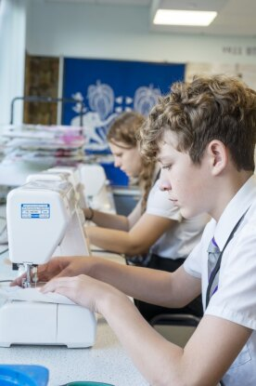
Curriculum:
English, Mathematics and Science
Languages
PSHE and citizenship
Computing
History
Geography
Religious Studies
Design Technology
Art
Drama, Music, Dance
PE
First Aid
Finance
Careers
Respect, Independence, Service to the Community, Empathy

Slide 11
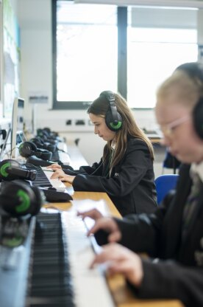
Extra-curricular opportunities:
Music lessons
Dance, talent shows
Trips – university educational/experience
Duke of Edinburgh
Other clubs and opportunities such as animi, gaming, chess, computer club, art club, history, etc
Competitive and recreational sport
Leadership opportunities – school council, Emergency cadets,
Fund raising
Respect, Independence, Service to the Community, Empathy

Slide 12
What we expect from pupils:
Respectful to staff and students.
Independence in their learning, attendance and attitude so that they are always working to the best of their ability.
Service to their community
Empathy thinking of others within school and the wider community
Being proud of Kingswood Secondary Academy-
our Academy.
Respect, Independence, Service to the Community, Empathy
Notes:
ABo

Slide 13
What we expect from parents:
  Your support:
  Sign the school contract and agree to the terms and conditions to the home/school agreement
  Send your sons/daughters to school on time every day. Attendance is paramount.
  Use the Class Charts log in to help monitor and support your child
  Ensure your child is in uniform and fully equipped to learn.
  Provide a quiet, purposeful place at home for homework completion.
  Attend parents and information evenings.
  Support the behaviour policy of the school.
  Talk to us first about any concerns.
  Don’t ask for holiday in term time!
Respect, Independence, Service to the Community, Empathy

Slide 14
Attendance is the key to success
  There is a direct correlation between high levels of attendance and: Happiness, Wellbeing, Good behaviour, and Improved outcomes.
  90% is good in an exam. It is not good in attendance terms.
  It is actually classed as persistently absence (Dfe National term) and in real terms means that you have 1 day off every two weeks.
  Your support:
  Your Son / Daughter will not feel 100% all of the time. Send them into the academy. Let us know. We can look after them and can send them home later if they are really too unwell to learn.
  Days 95% attendance minimum standard =94%= 10 days off= 50 lessons
  If you child is off school for any reason, you have to telephone in each day to tell the year team
Respect, Independence, Service to the Community, Empathy
Notes:
ABo

Slide 15

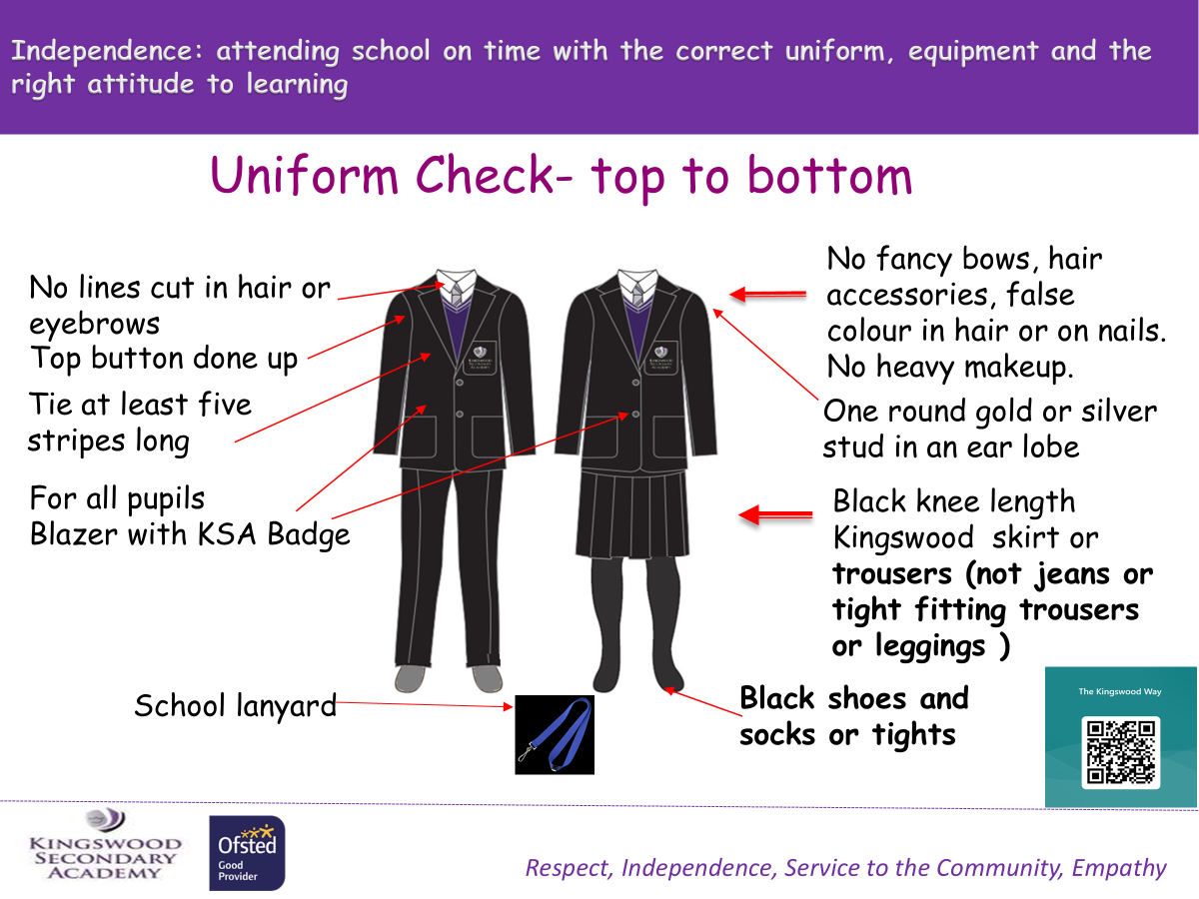

Form time and daily routines
S – Stationery
U –Uniform correct
P – Planner on the table
E – Equipment on the desk
R – Ready to start
Setting up for success
Respect, Independence, Service to the Community, Empathy

Slide 16
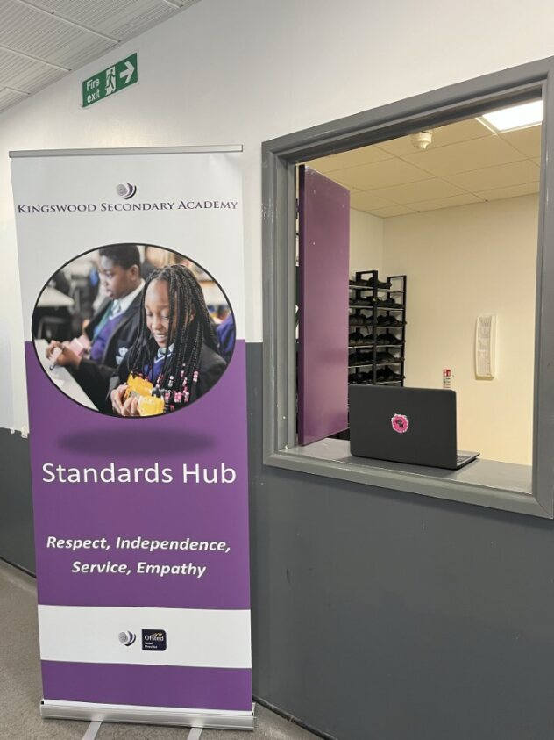
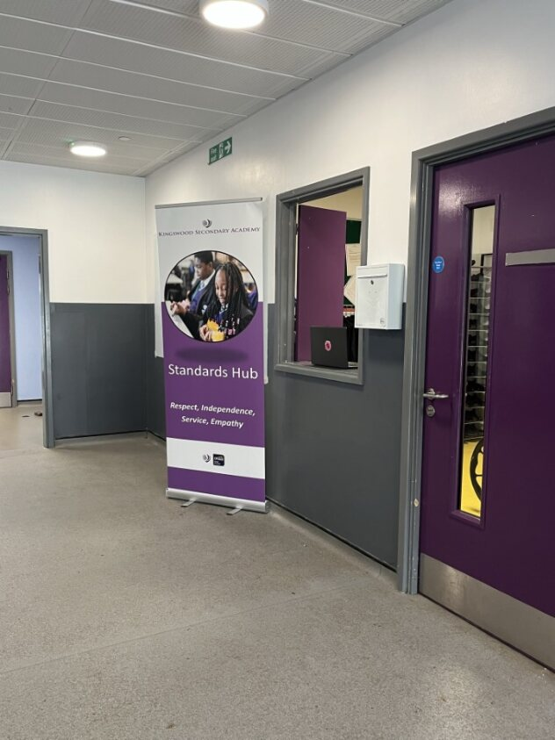
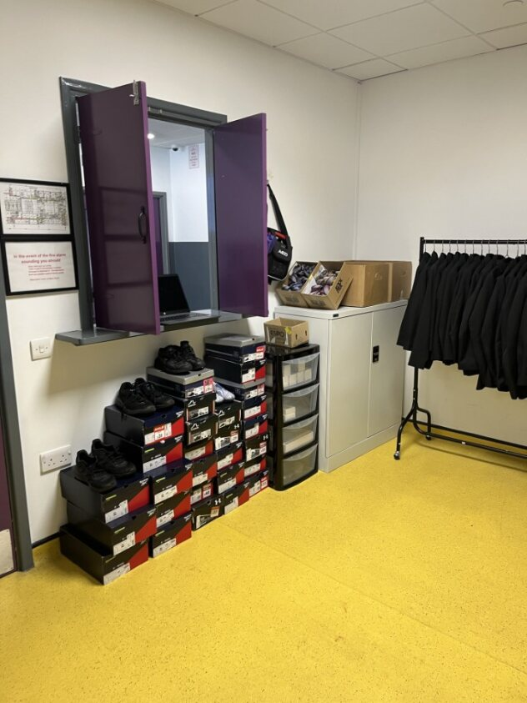
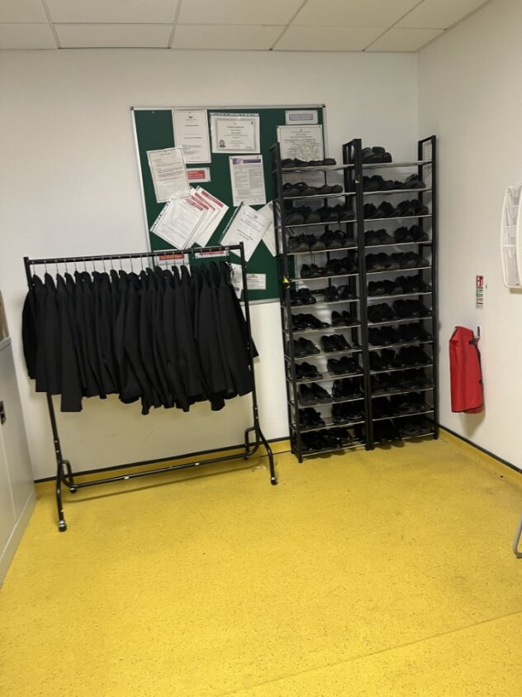
Standards Hub
Kingswood is kind and we wanted to move away from simply sanctioning students for not having the correct equipment.
The Hub is an opportunity for you to show independence and ready to learn before the school day starts (8am-8:30am)
You must return the borrowed equipment or uniform items at the end of the school day.
Respect, Independence, Service to the Community, Empathy
Notes:
LD

Slide 17
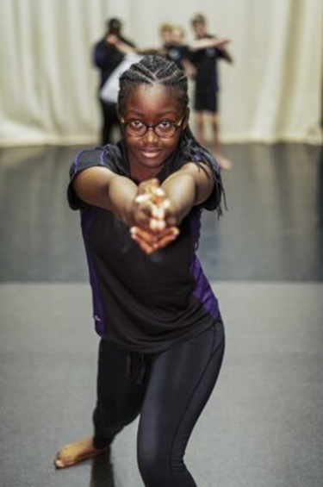

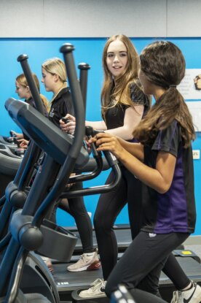

PE Kit and expectations
All students must engage and participate in PE and dance and drama lessons.
All students in dance and drama lessons must be in bare feet – or dance shoes national guidance on Health and Safety precaution.
Respect, Independence, Service to the Community, Empathy

Slide 18
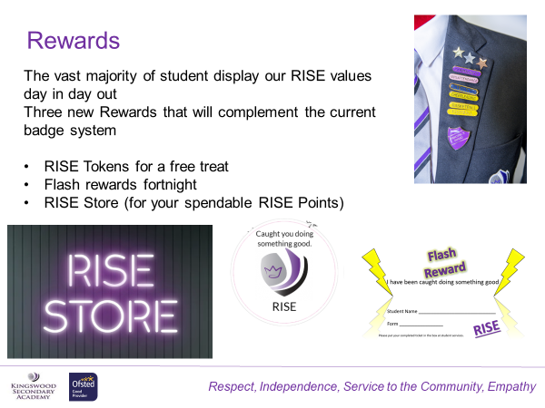
Respect, Independence, Service to the Community, Empathy

Slide 19

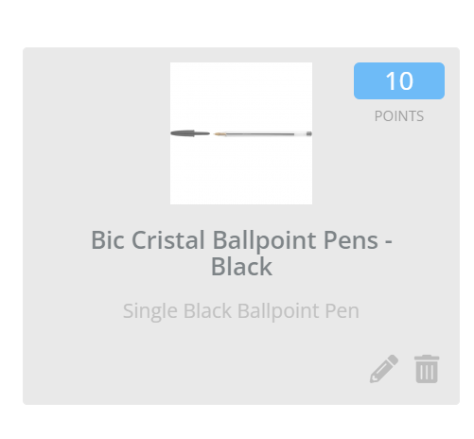
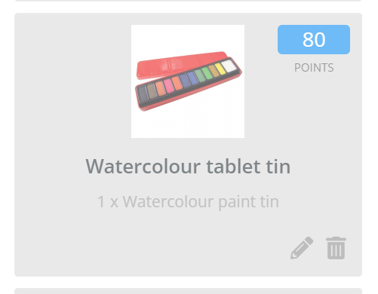

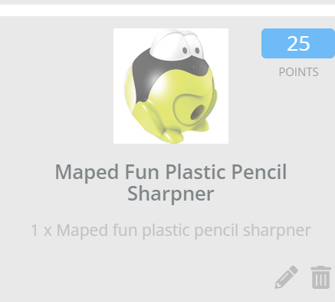
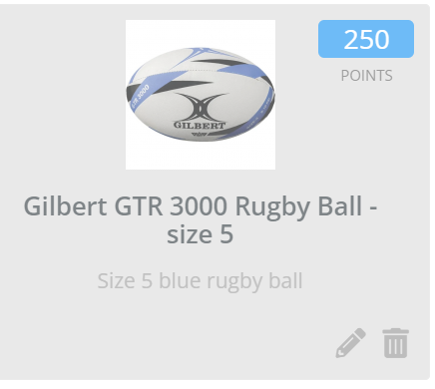
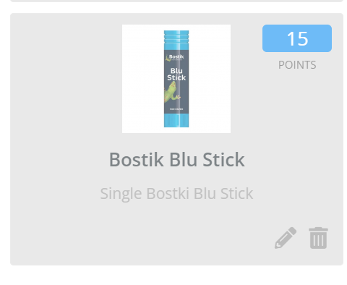
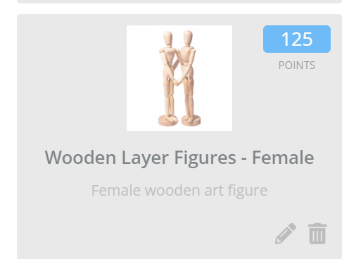
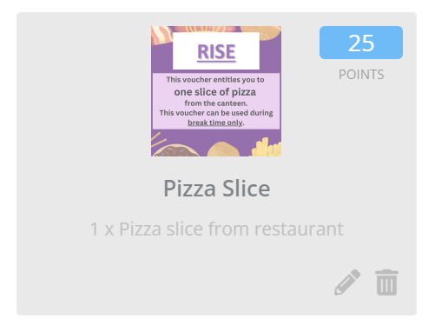
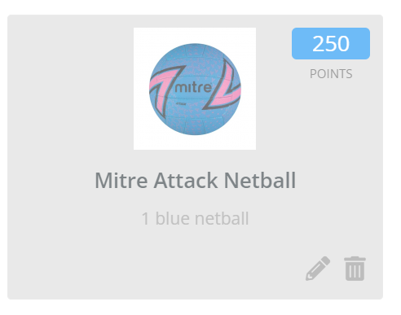
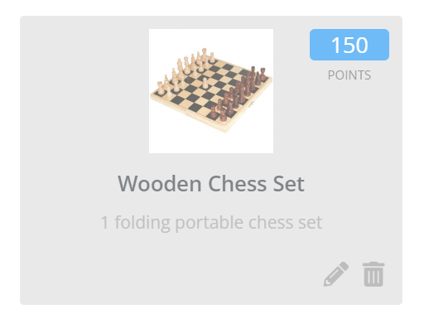
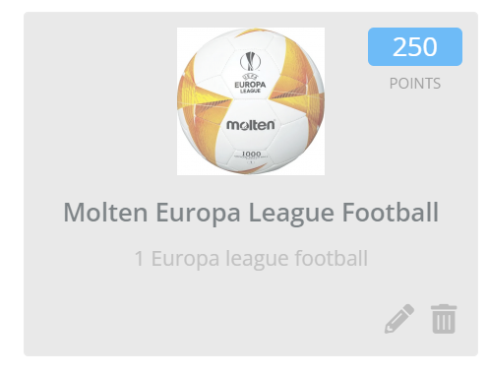
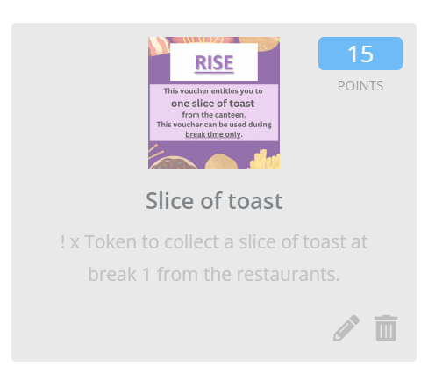
Respect, Independence, Service to the Community, Empathy

Slide 20

Changes to Free School Meals
LD
If your child is already eligible for and having Free School Meals, you will still need to reapply on a yearly basis.
If you receive Universal Credit, you will now be eligible for Free School Meals and should apply as soon as possible to ensure your claim is processed in time for September.
Even if you have No Recourse to Public Funds as a condition of your immigration status, your child may still qualify for Free School Meals under the changes.
Please see Lauren Dudley for information and forms :
Ldudley@kingswoodsecondaryacademy.org
It is important that you do not forget to apply or reapply for Free School Meals! NNC have reported processing delays so the sooner the better.
Notes:
LD

Slide 21
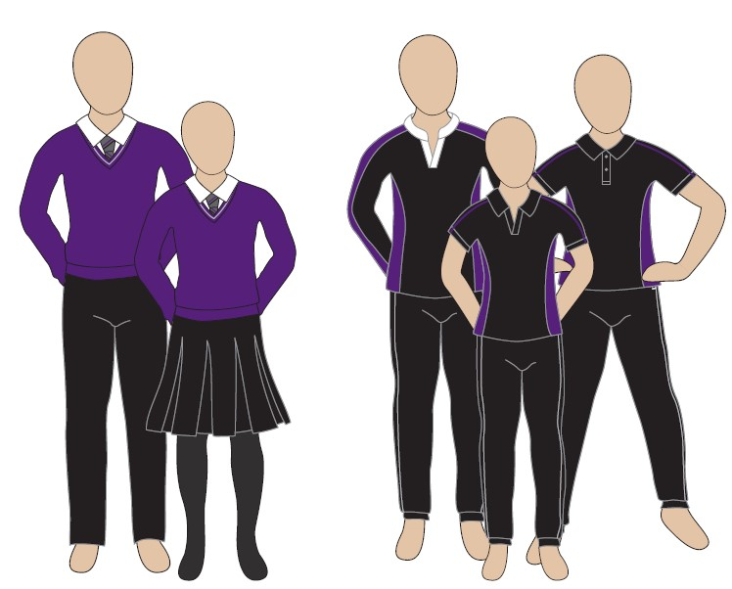

Swap Shop
Every Summer we are proud to host a Swap Shop in the atrium, supporting both the community and environment by gifting pre-loved uniform.
Everyone is welcome
No obligation to swap but please do donate if you can.
Come along and take what you need*
*One blazer per child.
Dates: Wednesday 22nd and Thursday 23rd July 11am – 1pm
Notes:
LD

Slide 22
ROM
The Year 7 team:
Mrs Rhiain O’Malley Head of Year 7
Mr Charlie Dawson Associate Head of Year 7
Mrs Glenda Forysyth Deputy Head of Year 7
The Head of Year and Deputy Head of Year are in our year 7 base and oversee the running and organisation of their team. They are responsible for:
Transition into the Kingswood Secondary Academy
Monitoring progress
Pupil well-being
Partnership with parents
Recognising achievement
Respect, Independence, Service to the Community, Empathy
Notes:
RO

Slide 23
Vision for the Year Group
We want every child to feel happy, confident and ready to succeed.
Positive supportive start
High expectations with care
Sense of belonging
Success
Respect, Independence, Service to the Community, Empathy

Slide 24
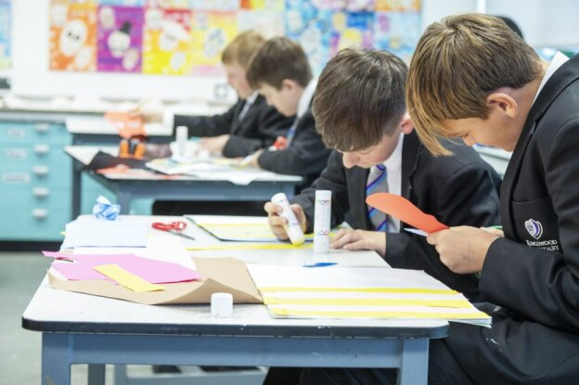
Year 7 ‘base’:
Based in the Science area for form time: 1 teacher and 1 room to ensure stability.
Year office is located there
Restaurant for just Year 7 & 8
Area at the back of school for exercising and socialising
Respect, Independence, Service to the Community, Empathy
Notes:
RO

Slide 25
Reminders:
ABO
Transition day is on Friday 3rd July students to arrive at 8:45 will finish at 3pm please ensure you pick up your child.
School will start at 8:30 on Tuesday 1st September
If you are free school meals, these will be provided
All students to attend in full school uniform
All uniform to be purchased through Price and Buckland (on our website)
All uniform to have your child’s name on.
If you are PP and need help with purchasing your child’s uniform, please contact the year team.
If you child loses a piece of equipment or uniform and you need to purchase more, please use the links on the website to purchase through our Parent Pay system.
Please ensure all letters of correspondence are signed and sent in with up-to-date contact details.
Your child on their visit, will come home with a Transition Times newsletter which has further information and should have the answers to any queries.
Respect, Independence, Service to the Community, Empathy
Notes:
RO

Slide 26
SEND
If your child has any special educational needs, please can you contact the SEND team directly on:
mhorsely@kingswoodsecondaryacaemy.org
Respect, Independence, Service to the Community, Empathy
Notes:
ABo

Slide 27
Transition day Friday 3rd July
Year 6 students to arrive at the academy between 8:45 and 9am wearing PE kit with their lunches – if your child is FSM, we will provide their lunch
Timetable of events/ getting to know you, school, each other
Teambuilding activities
To be picked up at 3pm
Respect, Independence, Service to the Community, Empathy
Notes:
ABo

Slide 28
Finally,
We are a team and a community who want the very best for our children. We will always try our best to ensure that the children in our care are always at the heart of any decisions made.
Your child’s success, is your success, is Kingswood’s success; we are a team.
Thank you
Respect, Independence, Service to the Community, Empathy
Notes:
ABo

