Slide 1
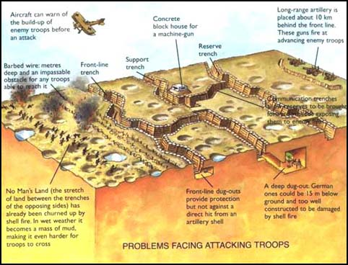
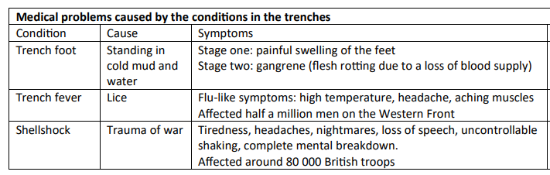
Long term causes of WWI:
Militarism – when countries race to build up their armies, navies and weapons. For example, Germany tried to build a warship like the British Dreadnought because they wanted a big army too.
Alliances – groups of nations who agree to back each other up in war. For example, the alliance between France, Great Britain and Russia called the Triple Entente.
Imperialism – to gain control of people and land and make them part of your empire. For example, Germany wanted to have an empire to get raw materials.
Nationalism – to have a pride in your own country and perhaps think it is superior to others. For example, Italy become a country in 1861 for the first time in 1,300 years and they were proud of this. They wanted to show the world its power.
Year 8 - Knowledge Organiser
What were trenches?
During World War I, the war was fought on the Western Front by soldiers in trenches. The trenches were long and narrow ditches dug into the ground where soldiers lived. It was very muddy and uncomfortable. The toilets overflowed too, which made the conditions even worse. Most trenches were 1-2 metres wide and 3 metres deep. Trenches weren’t straight lines; they had a zigzag pattern. On one side of the trenches, they were German. On the other side of the trenches, there were Allied. In between was No Man’s land. Soldiers crossed to attack each other.
Short term cause of WWI:
The assassination of Austria-Hungary’s Archduke Franz Ferdinand triggered World War One. On 28 June 1914, Franz Ferdinand and his wife were assassinated in Sarajevo by the 19-year-old Gavrilo Princip, a member of the Black Hand Gang.
Life in the trenches - BBC Bitesize
Conditions in the trenches:
Rats in the millions infested trenches. Gorging themselves on human remains they could grow to the size of a cat. A single rat couple could produce up to 900 offspring (babies) in a year, spreading infection and contaminating food. The rat problem remained for the duration of the war.
Boredom in the trenches:
Once the soldiers had completed the daily trench chores of refilling the sandbags, repairing the duckboards and trench floor, and draining the trenches, many of them became bored. They couldn’t really move around or do much as the fear of a sniper’s bullet was always there. To relieve the boredom, they used to write letters home and diaries.
KS3 / KS4 History: What were trench conditions like in World War One? - BBC Teach

Slide 2
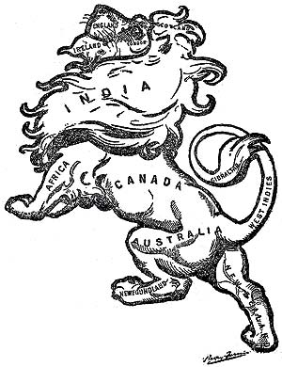
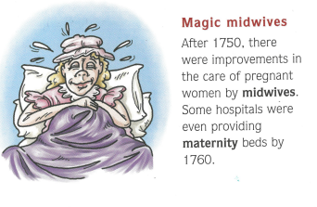

Harriet Tubman | Harriet Tubman escaped from slavery in the southern United States. She then helped lead many other enslaved people to freedom using the Underground Railroad. The railroad was a secret network that helped enslaved people find their way to freedom.
William Wilberforce | William Wilberforce was a British politician who helped to abolish the slave trade
Robert Stephenson | Robert Stephenson was an English civil engineer and designer of locomotives. He was the only son of George Stephenson, the "Father of Railways", he built on the achievements of his father.
Slave Trade | The 'Triangular Trade' was the sailing route taken by European slave traders. It was a journey of three stages: Western Europe; Western Africa and the Americas.
Middle Passage | The voyage from Africa to the New World of the Americas was called the Middle Passage. An enslaved person was chained and unable to go to the toilet and they had to lie in their own filth. Sickness quickly spread.
Empires | An empire is a collection of communities, regions, territories, states or even countries that are ruled over and controlled by one leader or ‘mother country’.
Navvies | Navvies were the canal and railway builders of the Industrial Revolution.
Coal Miners | Miners would breathe in thin layers of coal dust which would stick in their lungs, making them short of breath and cough up black mucus. This was called ‘Black Lung’. Underground pockets of gas easily explode if a candle was lit by a coal miner.

