Slide 1
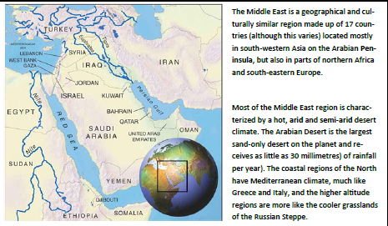
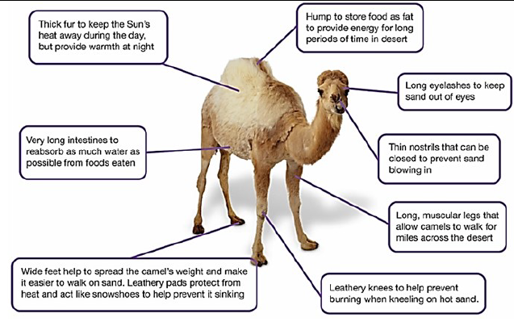
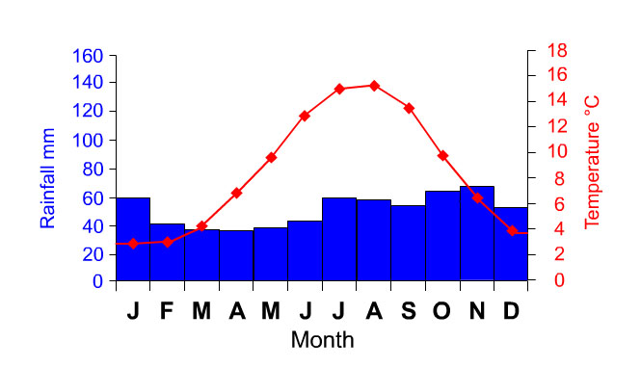
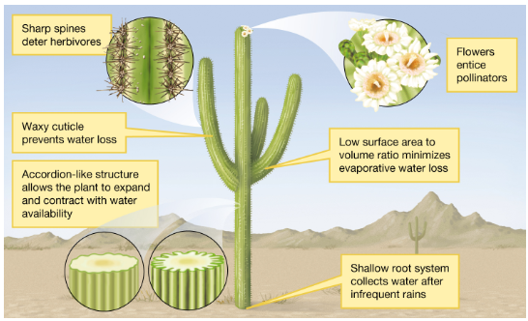
Climate graphs
Precipitation is in blue – bar chart
Temperature is in red – line graph

Slide 2
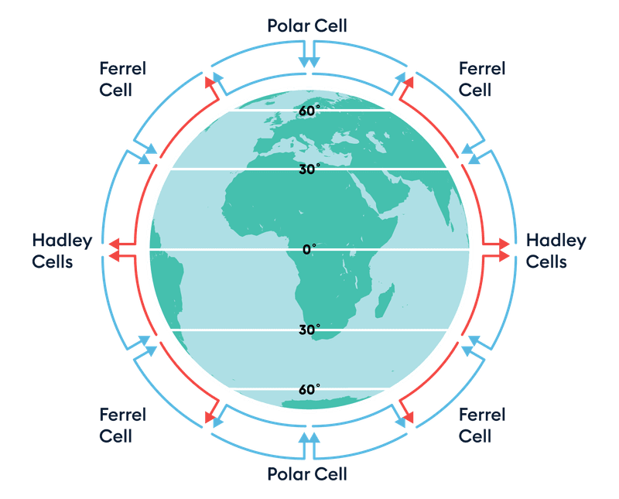
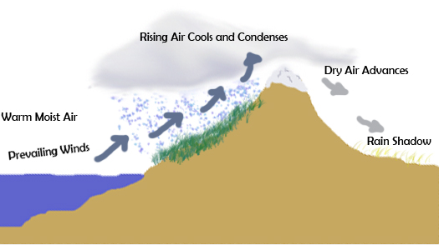
The Hadley Cell
Near the Equator, the sun is directly overhead, heating the air strongly.
As the hot air rises at the Equator, it cools, and heavy rain falls (this is why tropical rainforests are near the Equator).
Around 30° north and south, the air that rose at the Equator has cooled and sinks back down to the Earth's surface.
Sinking air causes high pressure means the air gets warmer and can hold more moisture — clouds can't form easily so you get dry, clear skies — perfect conditions for deserts!
The Rain Shadow Effect
Some deserts form because of mountains.
Moist air blows from the ocean and rises over mountains.
As it rises, the air cools and drops rain on the windward side (the side facing the wind).
When the air moves over the mountain, it has lost most of its moisture.
The other side (the leeward side) is dry — and this is called a rain shadow.
The Sahara Desert in Africa can be partly explained by this process due to the Atlas Mountains to the west of the Sahara desert.
Windward Leeward side

Slide 3
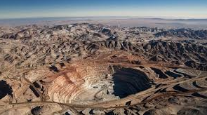
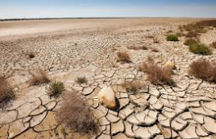
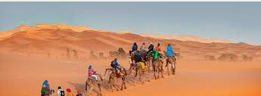
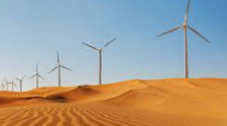
Opportunities in hot deserts | Challenges in hot deserts
Mining – Finding resources in the rock beneath deserts e.g. Feldspar in the Thar Desert | Population growth – need for more land is putting pressure on areas already struggling with resources e.g. Sudan, Africa
Energy – large expanse of land is perfect for renewable energy e.g. wind farms in the Thar desert | Water supply – low amount of water available due to low rainfall – impacts on people, animals and the environment
Farming – subsistence (for own family) farming as well as being able to sell the extra for profit | Climate change – uncertain future due to changing weather patterns due to climate change. Further decreased rainfall is possible, higher temperatures.
Tourism – brings in money to the local economy e.g. Thar Desert National Park. Allows people to visit while managing the potential impacts. | Desertification – the process of fertile land turning into infertile desert due to the spread of deserts. Issue in the Sahel region, south of the Sahara desert.
 | Tourism – large numbers of people can adversely impact deserts due to erosion by activities such as 4x4, sand surfing. People can also drop/leave litter.

